Slide 1
Land, Labor, Capital…and
Technology (the available set of techniques, methods, processes for producing goods & services)

Slide 2
Land, Labor, Capital…and
Technology (the available set of techniques, methods, processes for producing goods & services)
Entrepreneurship (people willing to bear risk—somewhat controversial to characterize this as a separate factor of production)

Slide 3
Land, Labor, Capital…and
Technology (the available set of techniques, methods, processes for producing goods & services)
Entrepreneurship (people willing to bear risk—somewhat controversial to characterize this as a separate factor of production)
Human capital (idea that investments in education, training, habit development, experience, etc. can increase productivity, i.e., the value of what people can produce with their labor.)

Slide 4
Question of legitimacy of ownership increasingly arise in 19th century
Is property theft? Who really owns land, labor, capital? Slavery abolished (thank goodness!) but other messy questions about legitimacy of other kinds of property rights remain to this day.

Slide 6
Dutch Feudal throwback in 19th Century Upstate New York?

Slide 7
Dutch Feudal throwback in 19th Century Upstate New York?
Philip Van Rensselaer III
“the last patroon”

Slide 8
New York Times gilded graphic

Slide 9
Source: Inequality, a contemporary approach to race, class, and gender,
Lisa Keister and Darby Southgate, Cambridge University Press, 2012

Slide 10
Down Rent War, around 1845
Artist: Mary Earley
From Smithsonian American Art Museum collection
http://americanart.si.edu/collections/search/artwork/?id=35972

Slide 11
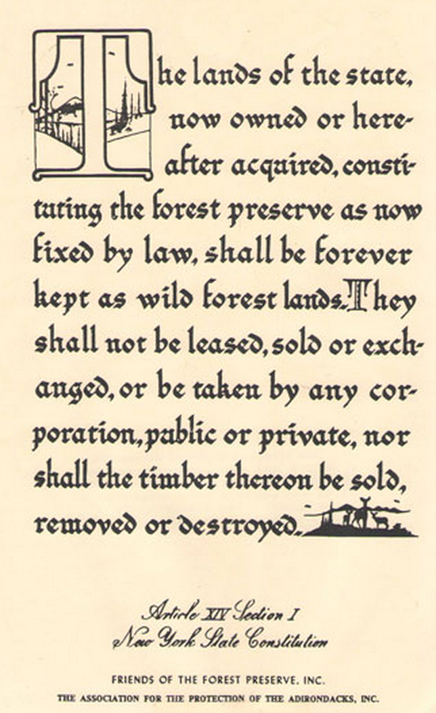

Slide 12
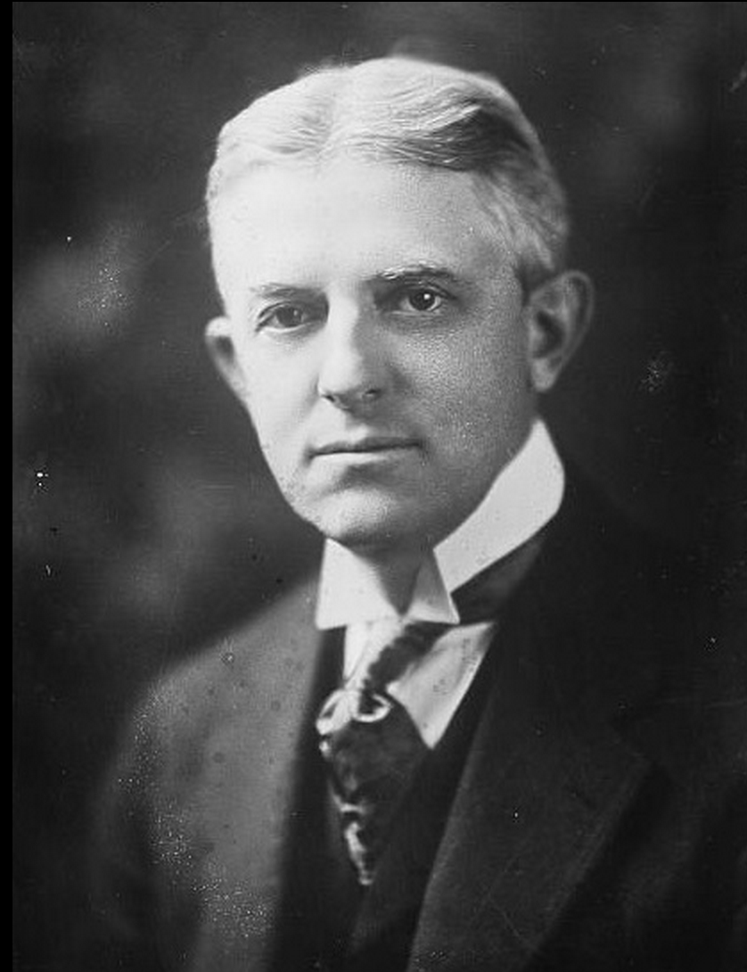
George Lunn,
Mayor of Schenectady
Socialist, 1911-13

Slide 13
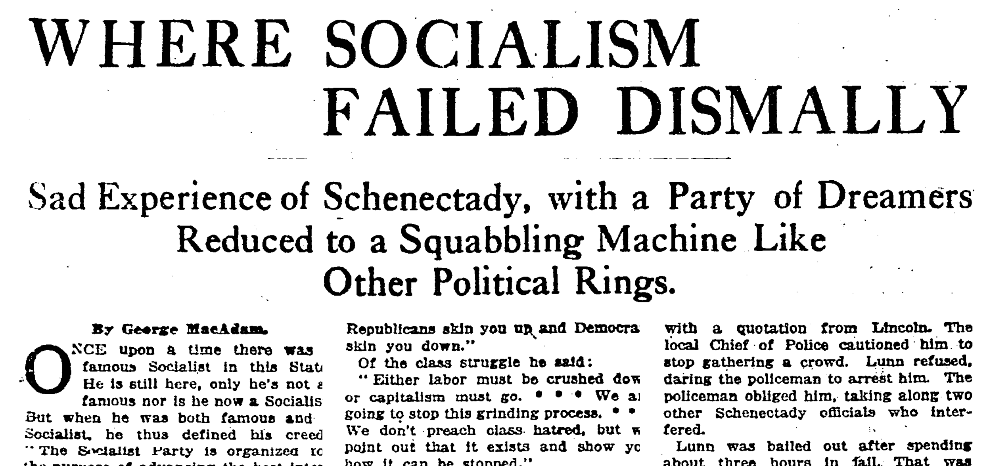
New York Times, 11/4/1917

Slide 14
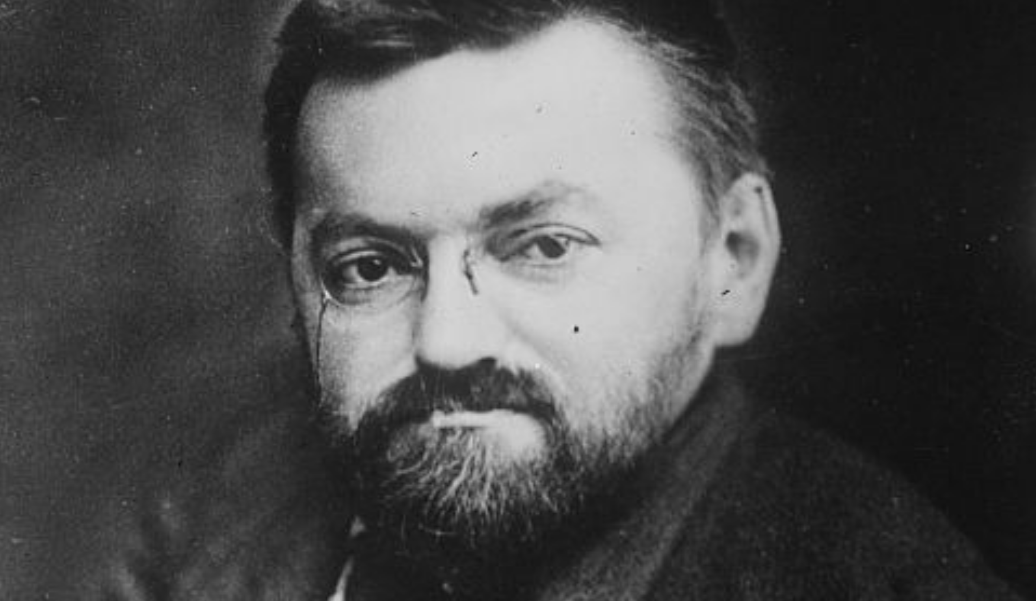
Charles Proteus Steinmetz, “Engineer and Socialist”
President, Schenectady School Board 1912-1916
President, Schenectady Common Council, Chair, Parks and Recreation Committee

Slide 15
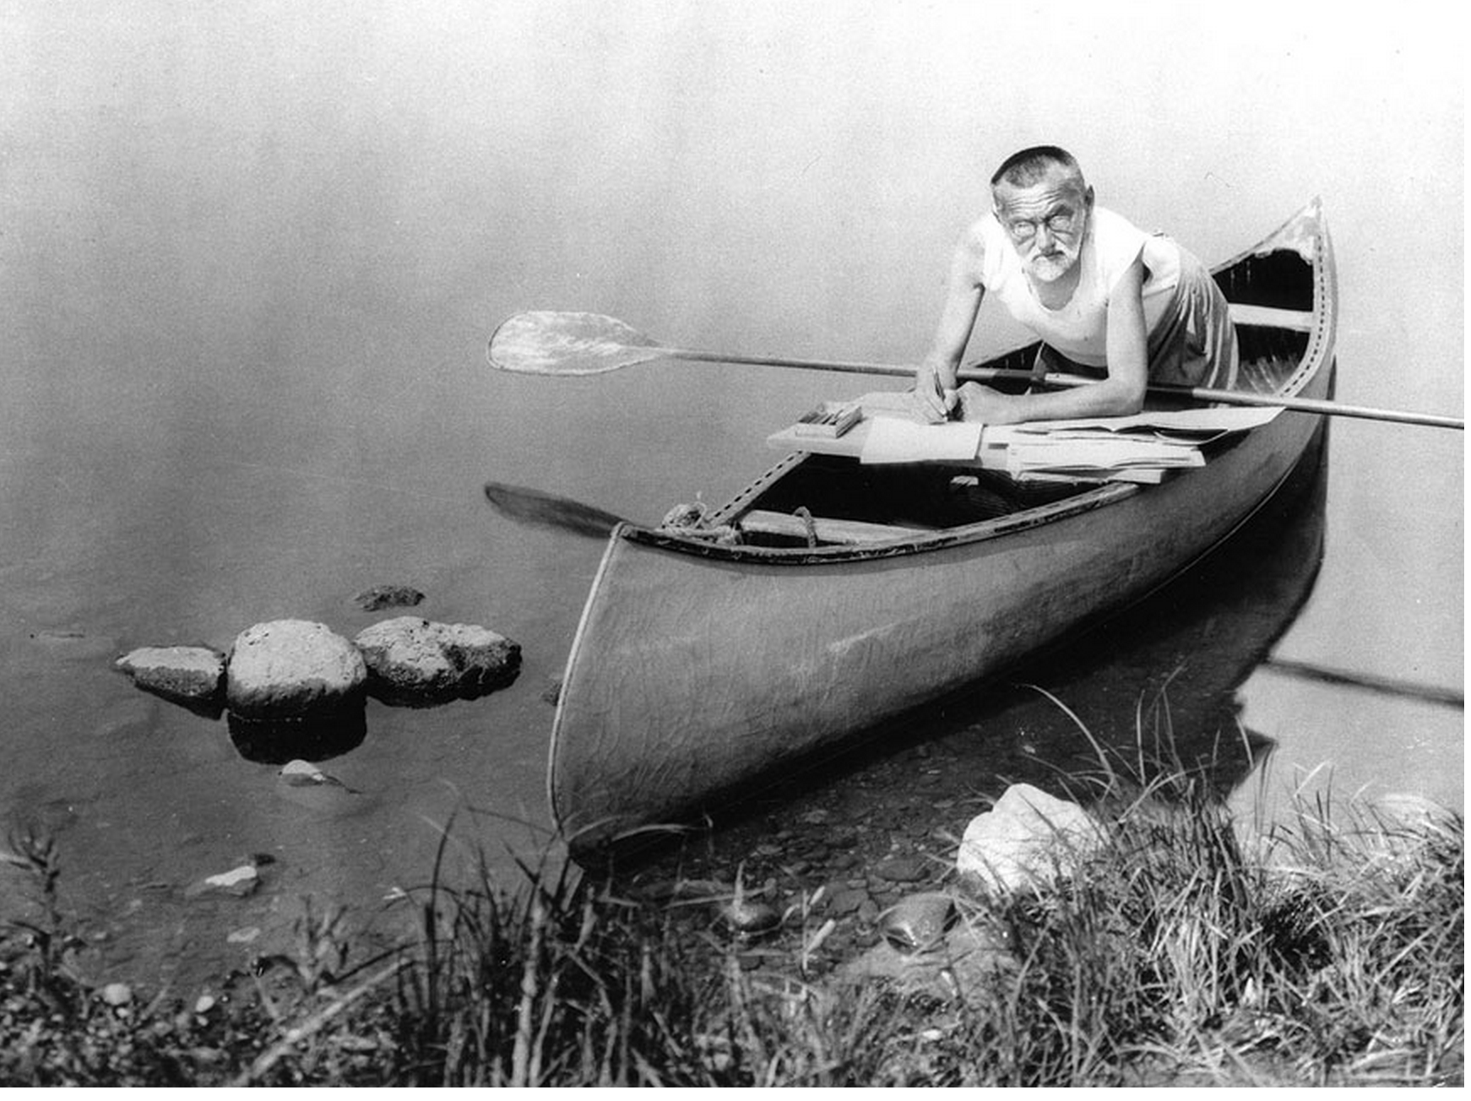

Slide 16
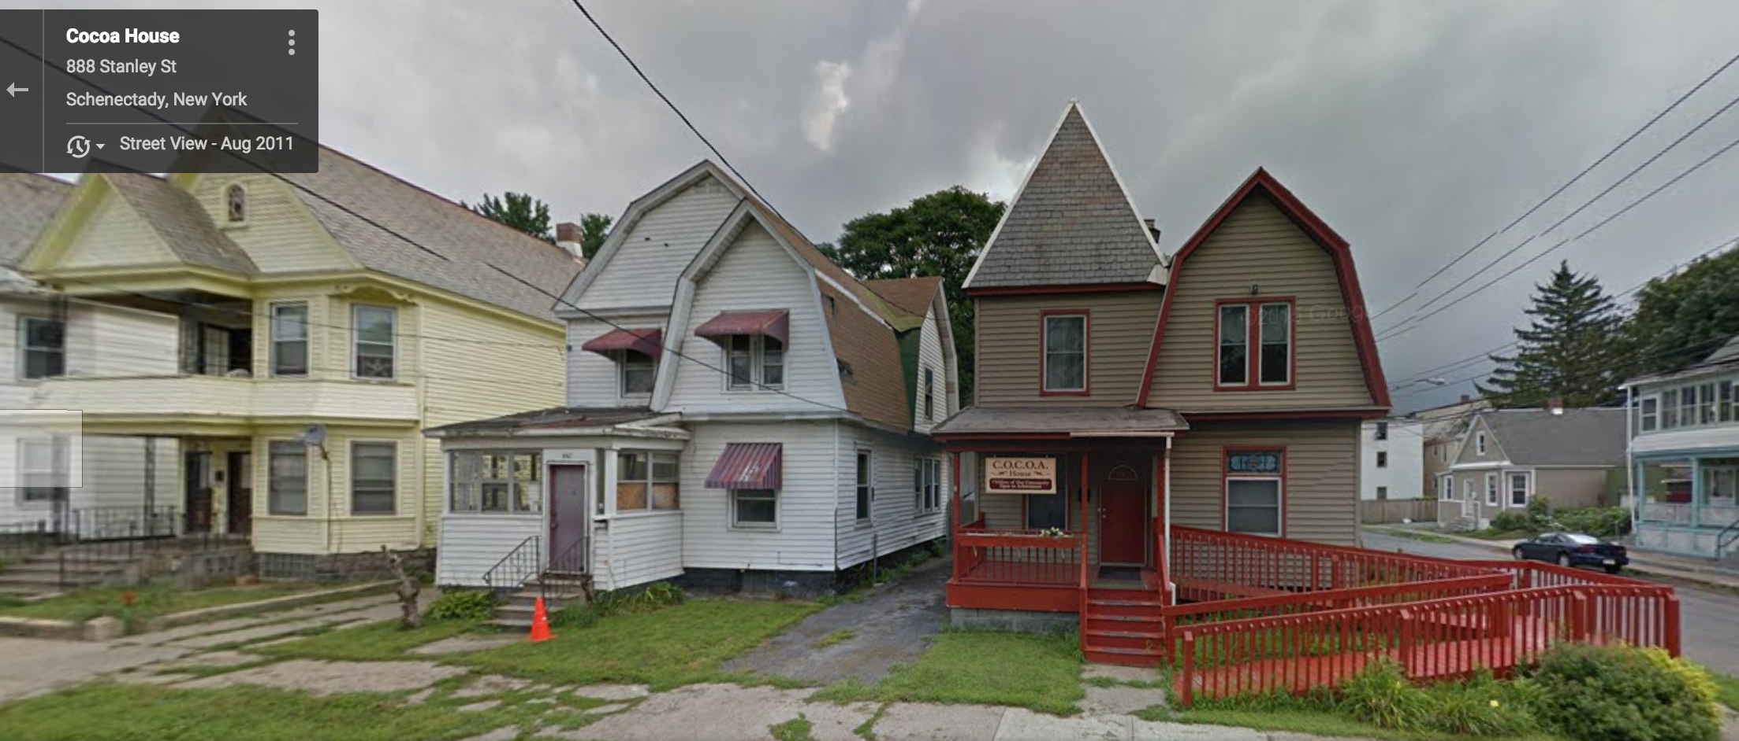
COCOA House (Hamilton Hill Schenectady)
(COCOA= “Children of the Community Open to Achievement”)
founded in 1996 by Union College student Rachel Graham class of 1998

Slide 17
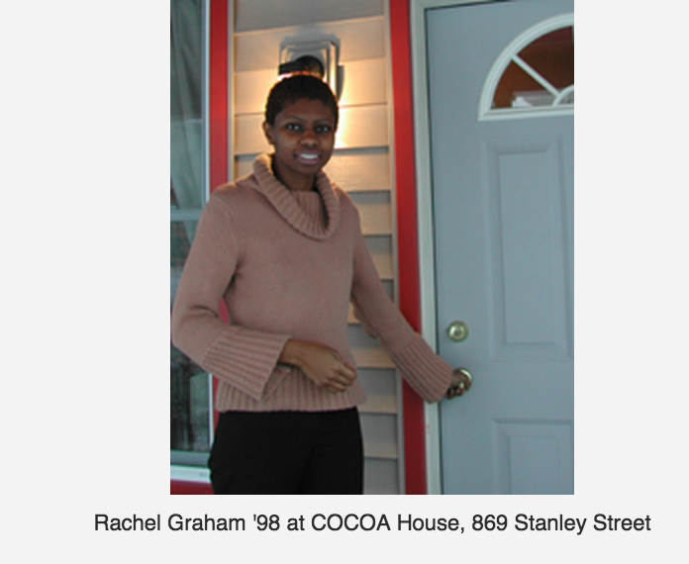
Program started in a church basement in 1996/ opened its own building in 2005—Facebook photo tour -- contact Prof. Jeff Witsoe

Slide 18
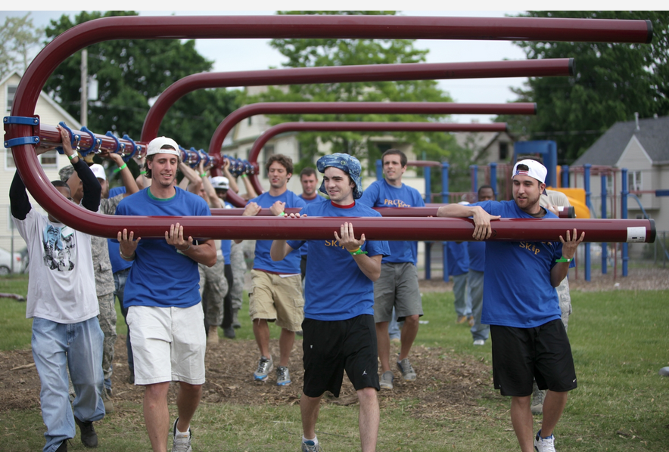
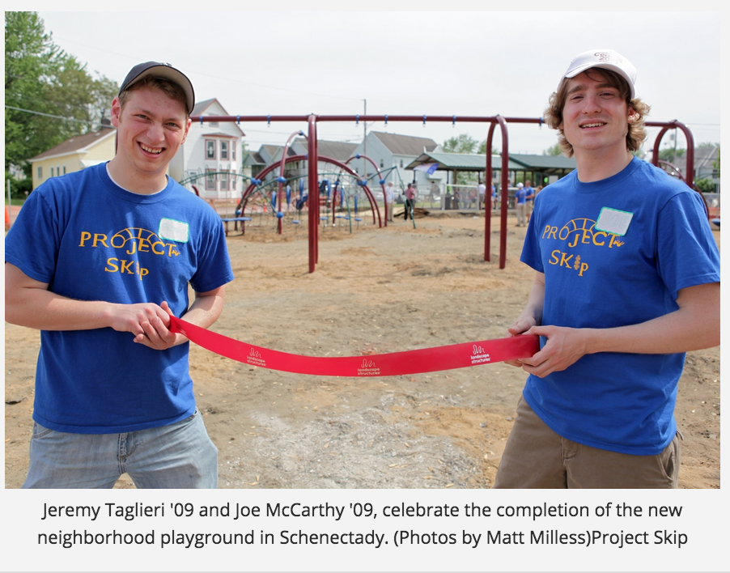
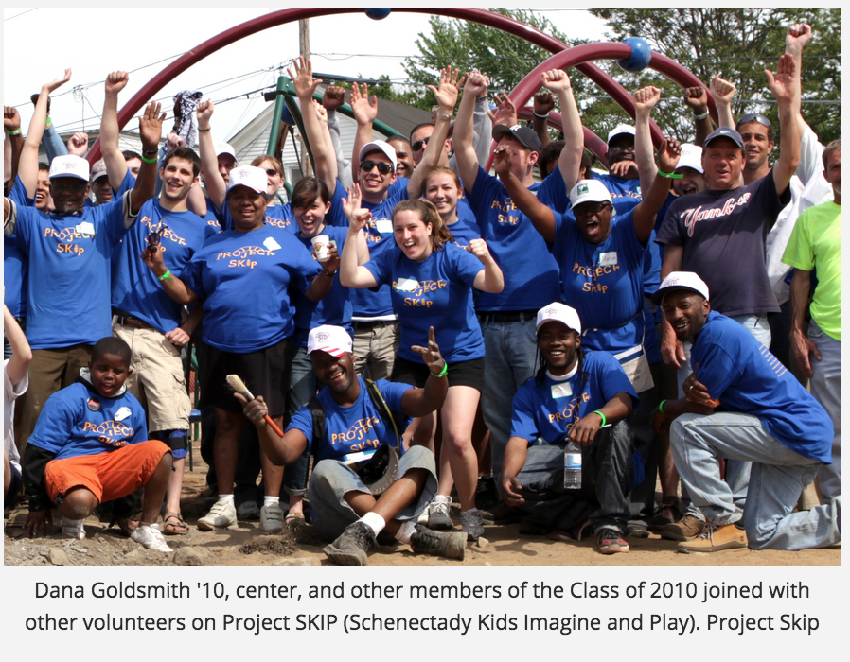
Project SKIP=“Schenectady Kids Imagine & Play”
Two Union students in class of 2009 worked with children and community volunteers in Hamilton Hill to design and renovate the playground at Jerry Burrell Park.
Notes:
Not a panacea! Playground is beautiful and greatly appreciated and used by the children, but there have been a number of daytime shootings (some fatal) within a block of the park!

Slide 19
During the DC riots following the assassination of Rev. Martin Luther King, Jr in 1968, a GWU college senior, Peggy Cooper from Mobile Alabama, sees the smoke rising from buildings surrounding her campus, just a few blocks from the White House.

Slide 20
What Peggy Cooper did (on a shoestring!) in summer 1968:
Started a small summer program “Workshop for Careers in the Arts” for 60 local high school students of all races (20 each in drama, dance, and drawing)
Hired talented (and underemployed!) AfricanAmerican professionals in the arts to teach in it.
The lead dance teacher was Mike Malone, a charismatic and brilliant choreographer/dance instructor.
Mike mentored a young college student who had lost her confidence.

Slide 21
”[Mike Malone] told me I was a dancer. I had stopped dancing altogether after a rejection from the North Carolina School of the Arts."
"He was responsible for me finding my path when I got lost,"
Washington Post

Slide 22
Within six years of launching that summer arts program launched by a college senior on a shoestring:
It had turned into a fulltime DC public high school for the arts, which is now the crown jewel of the system, with high artistic AND academic standards.

Slide 23
Within six years of launching that summer arts program launched by a college senior on a shoestring:
It had turned into a fulltime DC public high school for the arts, which is now the crown jewel of the system, with high artistic AND academic standards.
And remember the young assistant dance instructor Mike Malone mentored? She went on to become the first fulltime dance instructor at the new Duke Ellington High School of the Arts.
But that’s not all there is to say about her!

Slide 24
The status quo is unacceptable and likely to get worse without intervention.
Get involved/learn more!
Raise tough questions to elected officials
Get involved in political campaigns/advocacy? Community empowerment.
Paul Schaefer’s example—use the tremendous media tools available to you today.

