Slide 1
Schenectady as Inequality Action Laboratory?

Slide 2
Schenectady
As inequality observatory?
->Inequality in Schenectady is a remarkable microcosm of larger social phenomena (within walking distance of campus). What can we learn about the realities of the inequality surrounding us?
As inequality laboratory?
->There are potential opportunities not just to observe but possibly to intervene. What can we learn from past attempts by members of the Union College community to intervene?

Slide 3
First: a confession

Slide 4
First: a confession
My profession, economics, has not exactly covered itself with glory by spending a lot of effort and energy on inequality in the past.
Indeed, with a few notable exceptions, inequality has long been something of a “neglected stepchild” for economists.

Slide 5
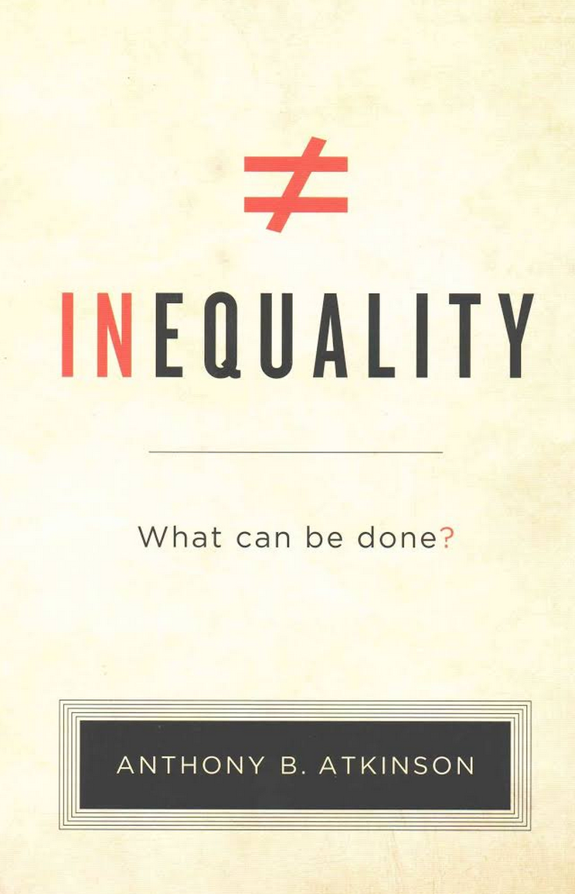
One particularly notable exception:
-work has focused on income inequality for past six decades! - Inequality: What can be done?, Harvard Univ Press 2015

Slide 6
Hugh Dalton (1920):
“[income] distribution, as between persons, was either left out of textbooks altogether, or treated so briefly as to suggest that it raised no questions which could not be answered either by generalizations about the factors of production or by plodding statistical investigations, which professors of economic theory were content to leave to lesser men.”
Quoted by Anthony Atkinson in Inequality: What can be done?

Slide 7
Gerard Debreu (1959)
“[T]his neglect [of income distribution] is still visible in introductory textbooks and books on microeconomic theory.”

Slide 8
Textbook used in Union’s Eco 101?

Slide 9
Textbook used in Union’s Eco 101?
Greg Mankiw, Essentials of Economics
Notes:
Mankiw’s book is very standard—probably most widely used introductory textbook. Mankiw was Chair of the President’s Council of Economic Advisors under GW Bush.

Slide 10
Textbook used in Union’s Eco 101?
Greg Mankiw, Essentials of Economics
Mankiw’s criterion for inclusion in Essentials: “to emphasize the material that students should and do find interesting about the study of the economy.”

Slide 11
Textbook used in Union’s Eco 101?
Greg Mankiw, Essentials of Economics
Mankiw’s stated criterion for inclusion in Essentials: “to emphasize the material that students should and do find interesting about the study of the economy.”
The chapter on “Income Inequality and Poverty” did not make the cut!

Slide 12
Sometimes, economists do worse than just neglecting inequality, they argue for actively exploiting it!

Slide 13
Memo circulated in 1991 by Larry Summers (then chief economist at World Bank, later US Treasury Secretary under Bill Clinton, then President of Harvard…)
“The measure of the costs of health-impairing pollution depend on the foregone earnings from increased morbidity and mortality. From this point of view a given amount of health-impairing pollution should be done in the country with the lowest cost, which will be the country with the lowest wages. I think the economic logic behind dumping a load of toxic waste in the lowest-wage country is impeccable and we should face up to that.”
Quoted in Ackerman/Heinzerling’s essay on “Inequality of Hazard” in The Perils of our Growing Inequality

Slide 14
Brazil Secretary of the Environment’s Response to Larry Summers
“Your reasoning is perfectly logical but totally insane. … Your thoughts [provide] a concrete example of the unbelievable alienation, reductionist thinking, social ruthlessness and the arrogant ignorance of many conventional ‘economists’ concerning the nature of the world we live in.”
Quoted in Ackerman/Heinzerling’s essay on “Inequality of Hazard” in The Perils of our Growing Inequality

Slide 15
Not all economists are like Larry Summers!!!!
But—he’s not the only one like that—so you are right to be wary around economists!

Slide 17
Can you guess where I was born & raised?
In my birth year (1953), public schools in my city were racially segregated de jure (by law). There were spacious new public schools legally restricted to white students. The schools designated for “Negro students” were aging and overcrowded (with double and sometimes triple shifts) while nearby white schools were sometimes half-empty.

Slide 18
Can you guess where I was born & raised?
In my birth year (1953), public schools in my city were racially segregated de jure (by law). There were spacious new public schools legally restricted to white students. The schools designated for “Negro students” were aging and overcrowded (with double and sometimes triple shifts) while nearby white schools were sometimes half empty.
Even though they were all adult US citizens born and raised in this country, neither my parents, nor my grandparents, nor any of our neighbors had the right to vote for any of the government officials who made and enforced these segregation policies!

Slide 19
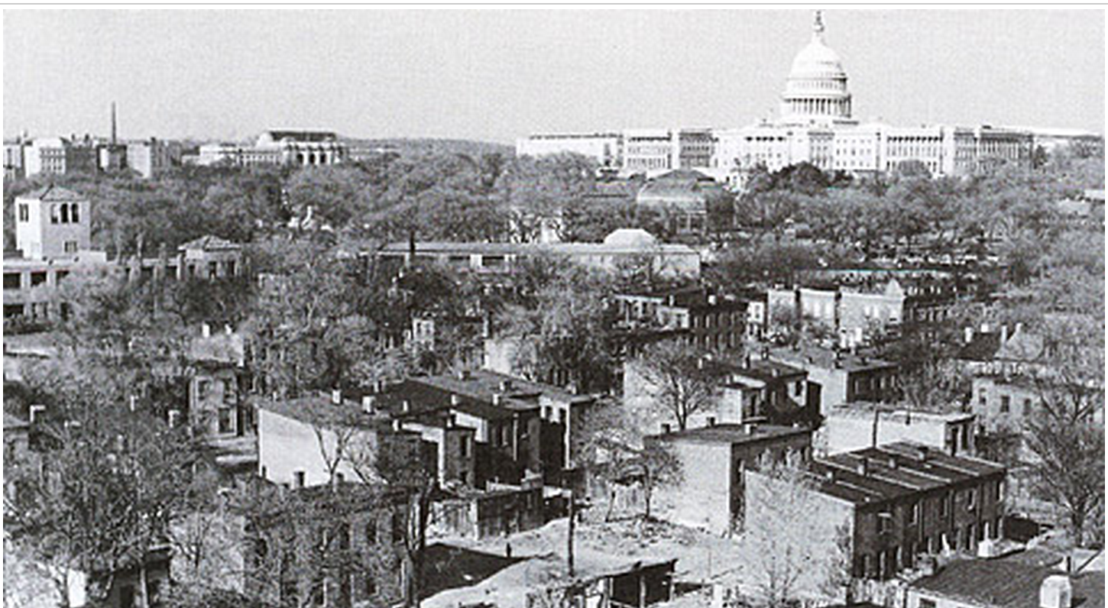

Slide 20
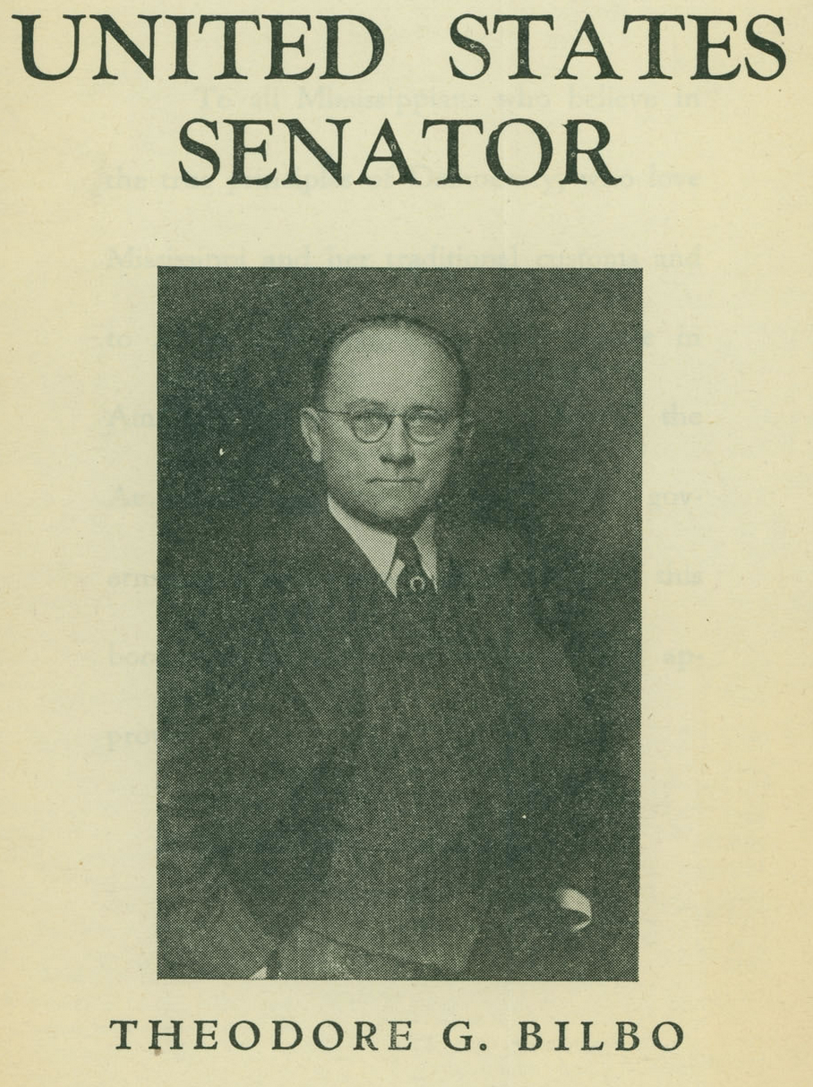
“Senator Bilbo is Chairman of the Senate Committee on the District of Columbia which makes him ex officio the Mayor of Washington.”
-quotation from campaign re-election flyer for Senator Bilbo

Slide 21
Irony
The Supreme Court ordered an end to de jure segregation in DC in 1954.
However, due to a combination of residential segregation patterns and academic placement procedures, the DC public schools have remained very highly segregated to this day.
Notes:
In my last year in DC public schools (1969-70), six of my seven academic classes were all white; my seventh class had a single African American student. (However, students in the building were 2/3 African American. School officials rarely placed them in the honors classes.) Ironically, the best teacher I had at that school, someone who likely changed my life in a very positive way, was my chemistry teacher, an African American!

Slide 22
American Apartheid Harvard University Press (1993)
“Hypersegregation”
Black ghetto “created by whites during the first half of the 20th century in order to isolate growing urban black population.”

Slide 23
American Apartheid Harvard University Press (1993)
Black ghetto “created by whites during the first half of the 20th century in order to isolate growing urban black population.”
Racial restrictive covenants declared “unenforceable” by Supreme Court in 1948 and the Fair Housing Act outlawed discrimination in 1968, but “hypersegregation” residential patterns continue to perpetuate decades later.

Slide 24
City of Schenectady puzzle
Overall poverty rate is less than 25%.
Poverty rate for households with children is greater than 50%.
Poverty rate for households with children in Schenectady public schools may be even higher.
How to reconcile these disparate facts?
Good news/bad news answer!

Slide 25
Good news/bad news answers
Good news (relatively): Thanks largely to Social Security (and somewhat to pensions for many local current retirees), the elderly in Schenectady have lower poverty rates.

Slide 26
Good news/bad news answers
Good news (relatively): Thanks largely to Social Security (and somewhat to pensions for many local current retirees), the elderly in Schenectady have lower poverty rates.
Bad news (EXTREMELY): Families with school-age children who have a choice (i.e., middle class and above) are choosing to live elsewhere. A large number of school age children in Schenectady are part of households with no real choice about where to live (e.g., in public housing, section 8 subsidized rentals, living with extended family, etc.) Result is socioeconomic hypersegregation, with disparate racial consequences.

Slide 27
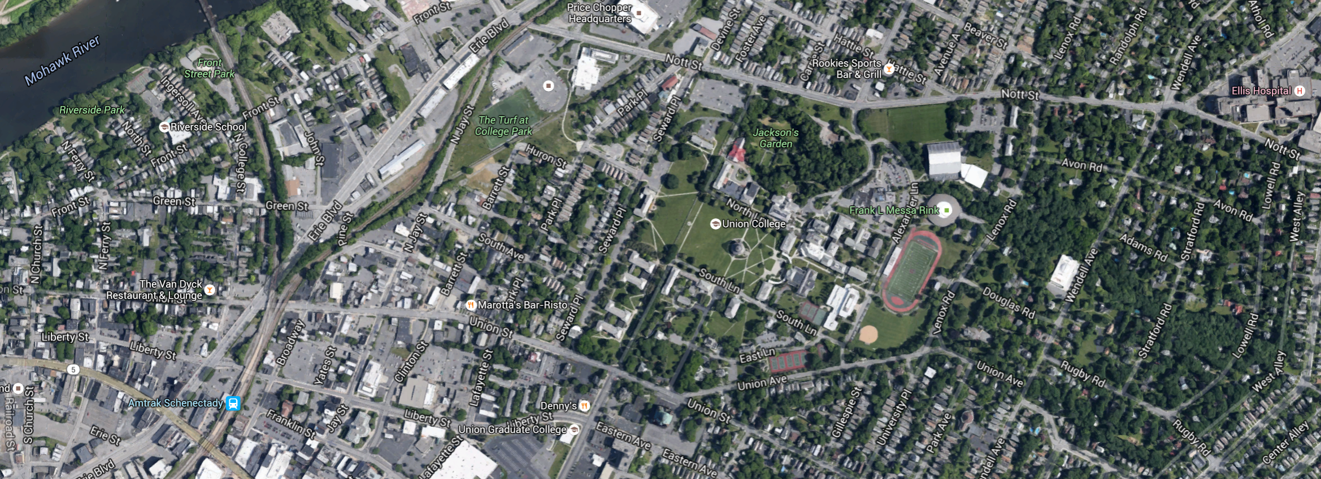
B- Stockade
F- General Electric Realty Plot
E-College Park
Neighborhood
Notes:
How many of you have visited each of these neighborhoods?

Slide 28
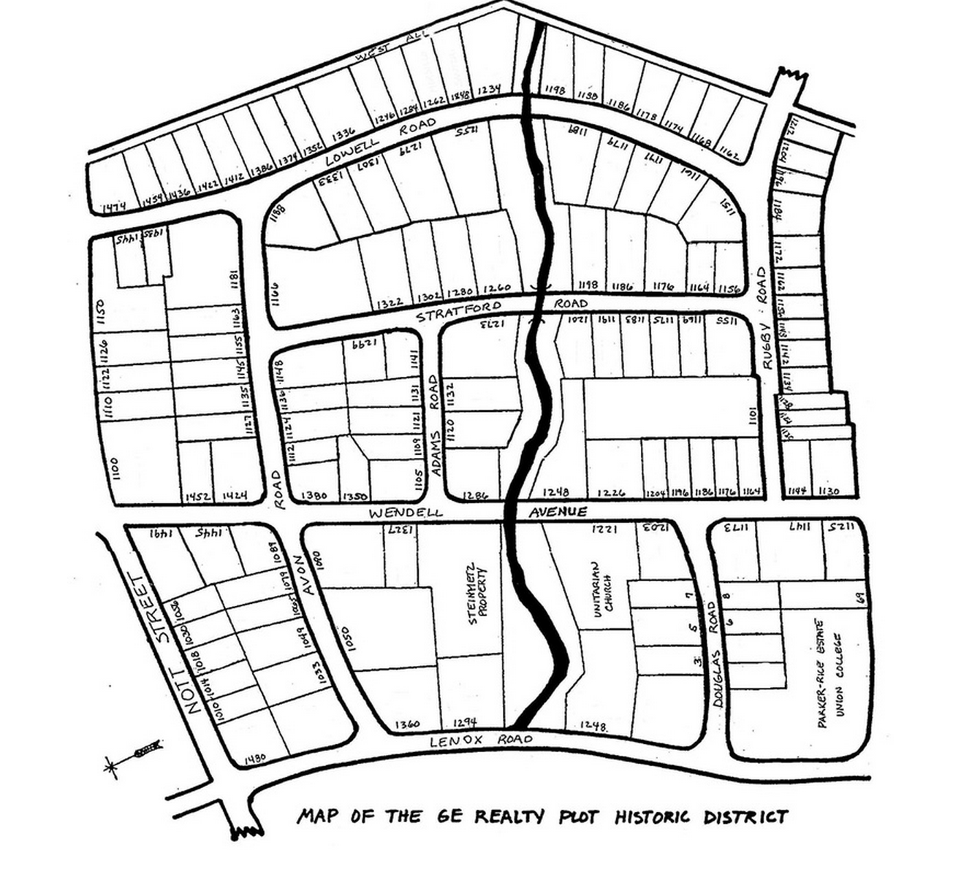
B- Stockade
F- General Electric Realty Plot Plot
E-College Park
Neighborhood
Notes:
How many of you have visited each of these neighborhoods?

Slide 29
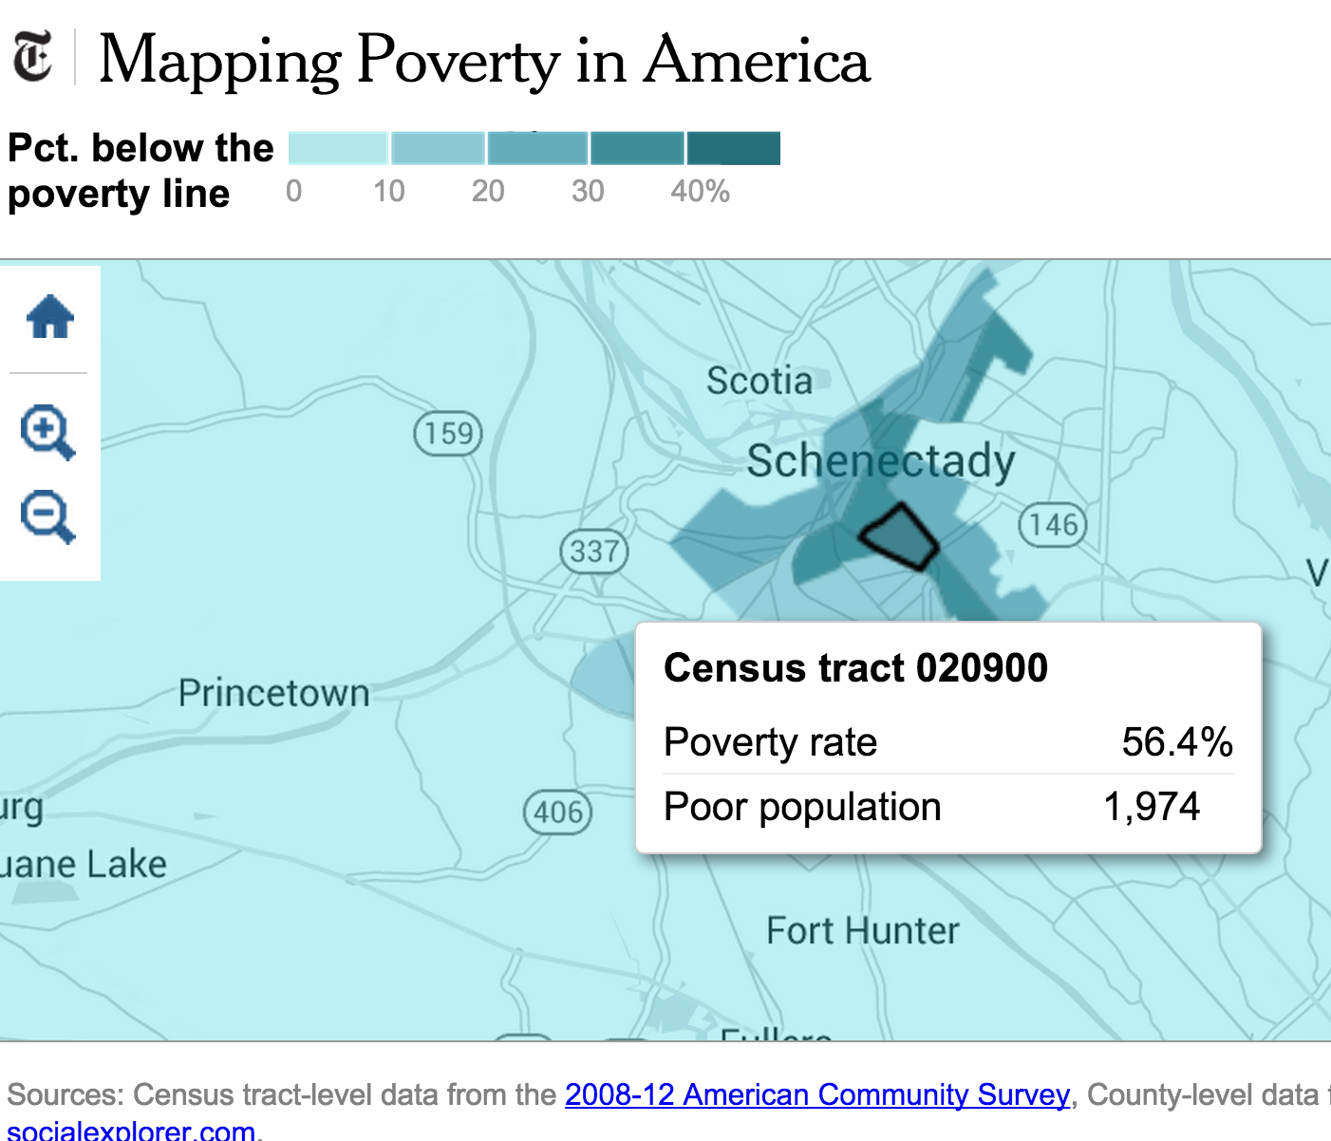

Slide 30
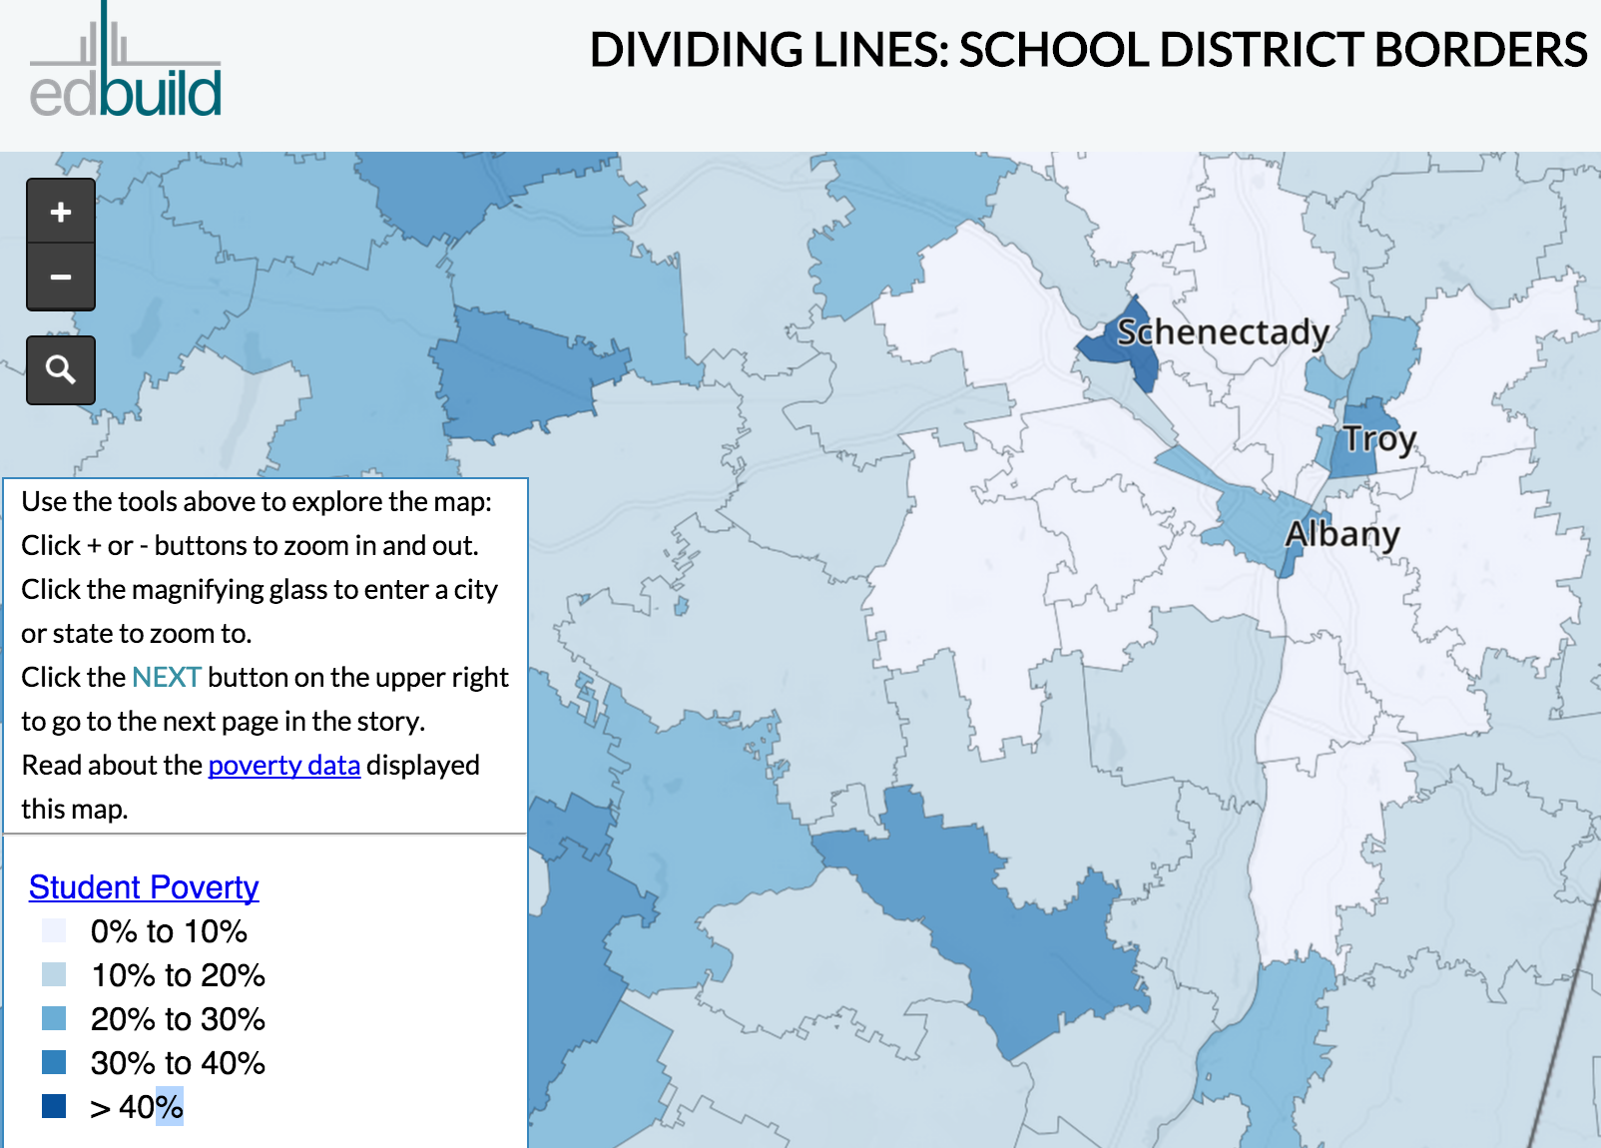
Notes:
http://maps.edbuild.org/DividingLines.html#

Slide 31
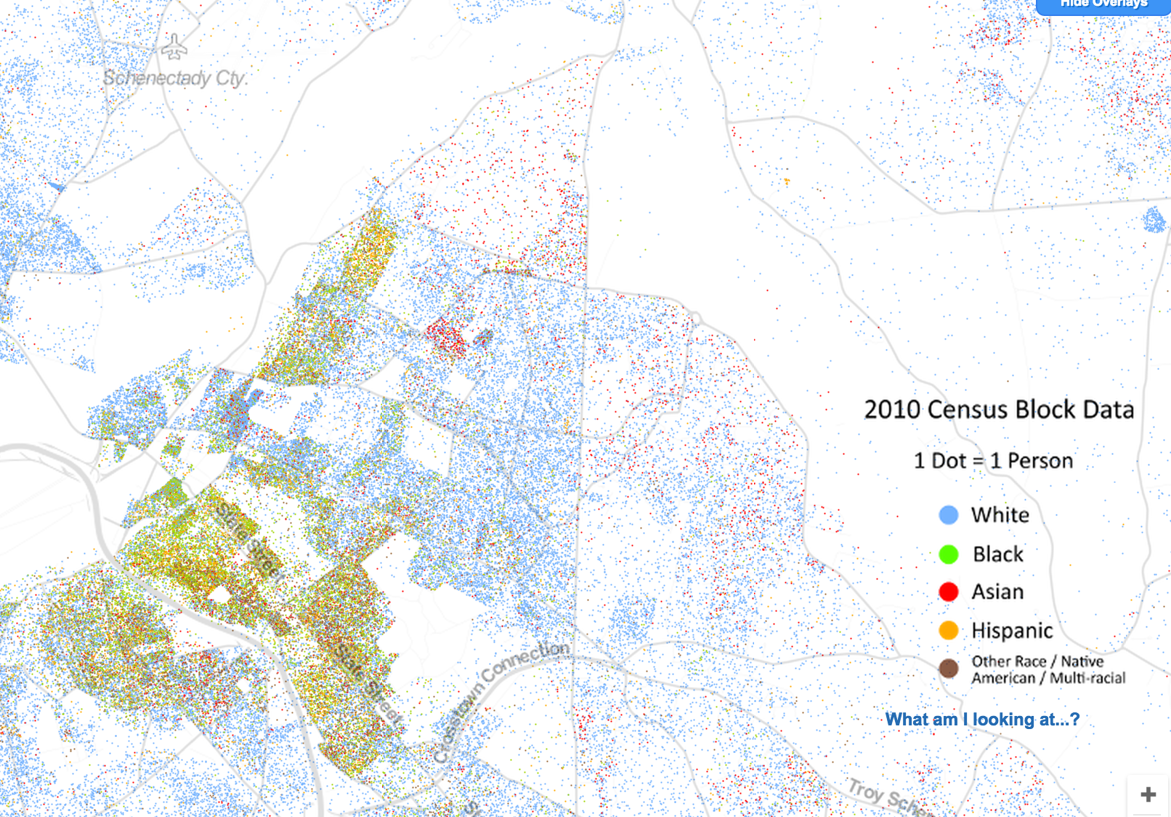
Image copyright 2013 Weldon Center for Public Service,
University of Virginia (Dustin Cable, creator)

Slide 32
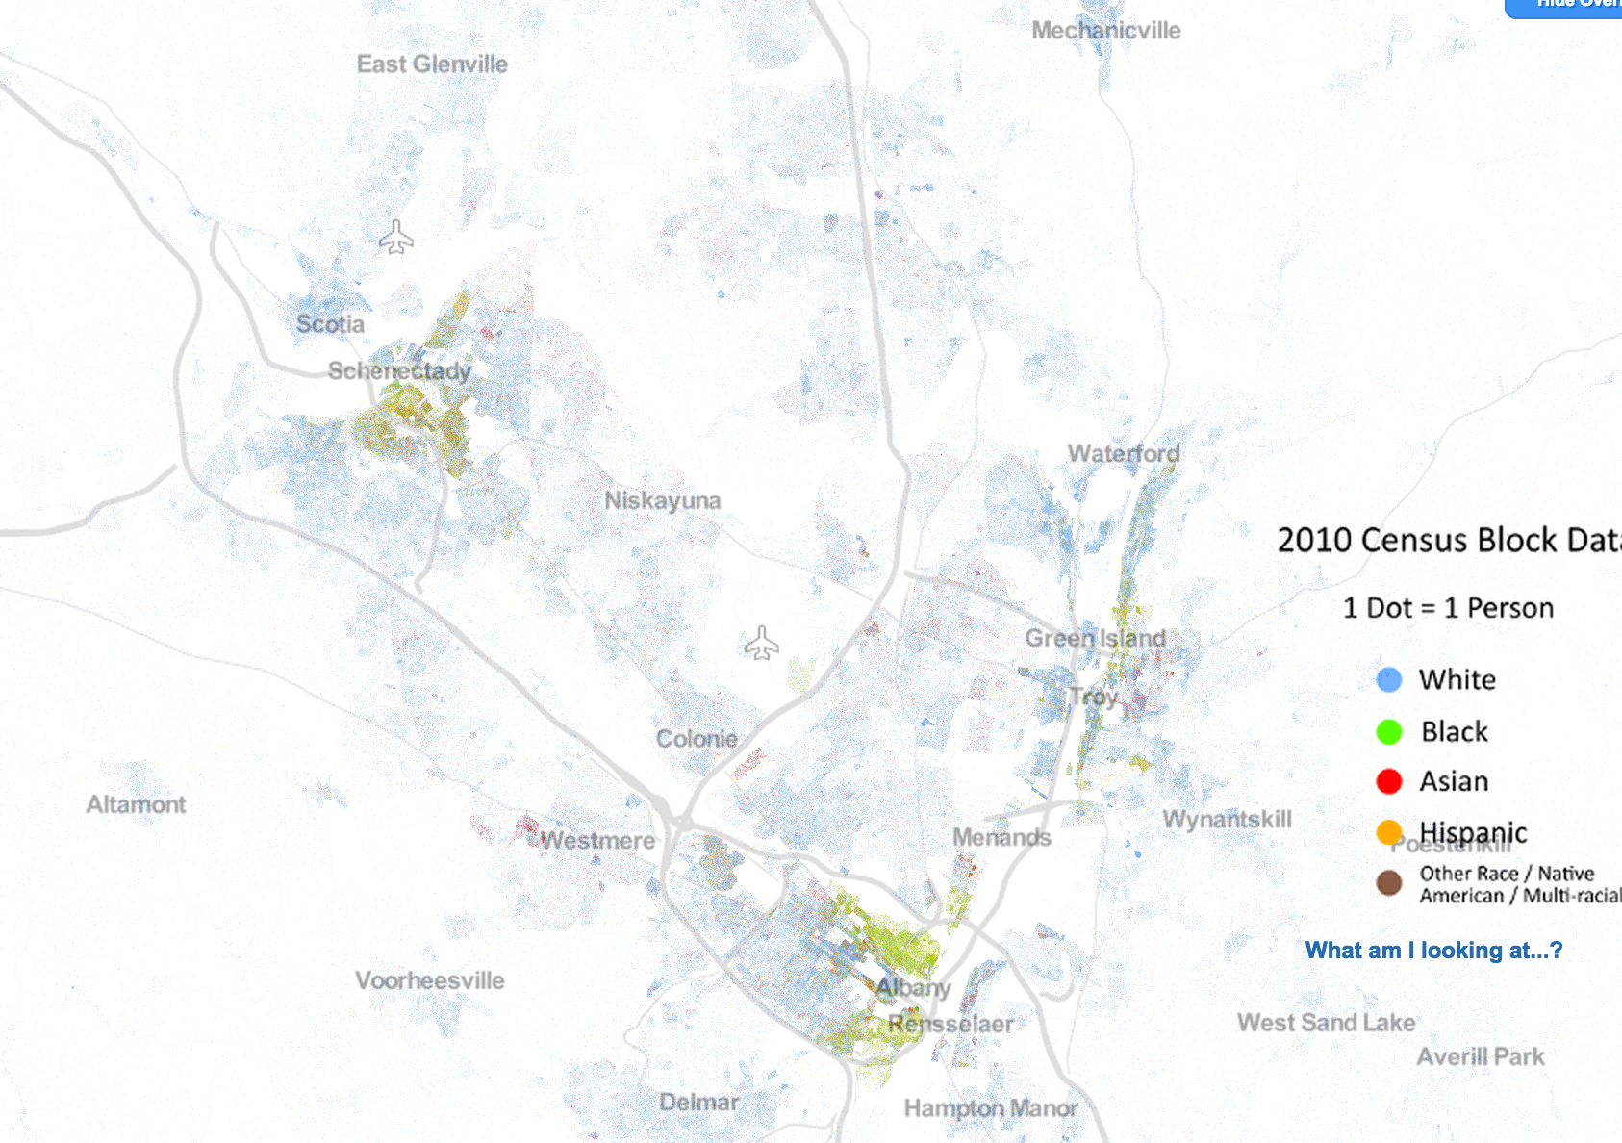
Image copyright 2013 Weldon Center for Public Service,
University of Virginia (Dustin Cable, creator)

Slide 33
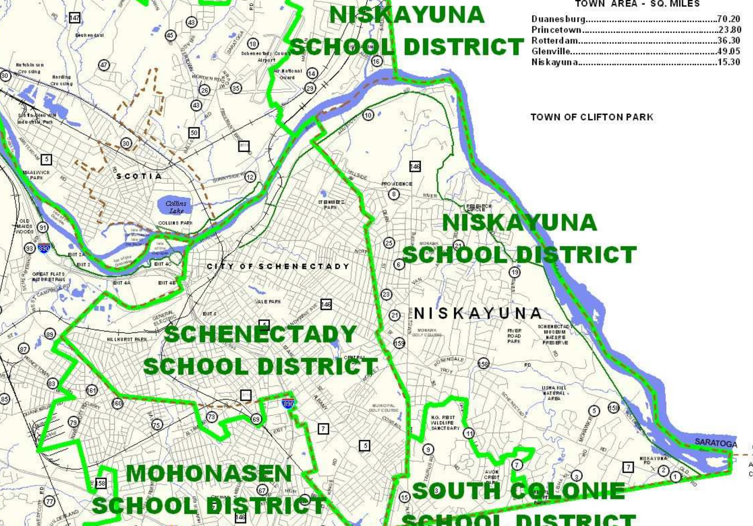
Schenectady eligible free/reduced lunch >80% Niskayuna eligible free/reduced lunch 8%
273 students dropped out 4 students dropped out
Graduation rate: 58% Graduation rate 99%
Child poverty rate >50% (second highest in NY) Child poverty rate <4% (lowest in upstate)

Slide 34
Capital District Business Review School District Rankings—at the top of the list:
Capital District Business Review School District Rankings—at the bottom of the list:

Slide 35
“Among OECD countries, only Israel, Slovenia, Turkey, and the United States favor socio-economically advantaged schools with more teachers.”
Source: OECD 2011 report quoted by Edward Kleinbard We are better than this: How the government should spend our money

Slide 36
Schenectady challenges
Pedro Roman, principal of Lincoln Elementary School in Schenectady: in one third grade class last year, ten of the children had at least one parent incarcerated. Six of those had both parents incarcerated.
--Daily Gazette

Slide 37
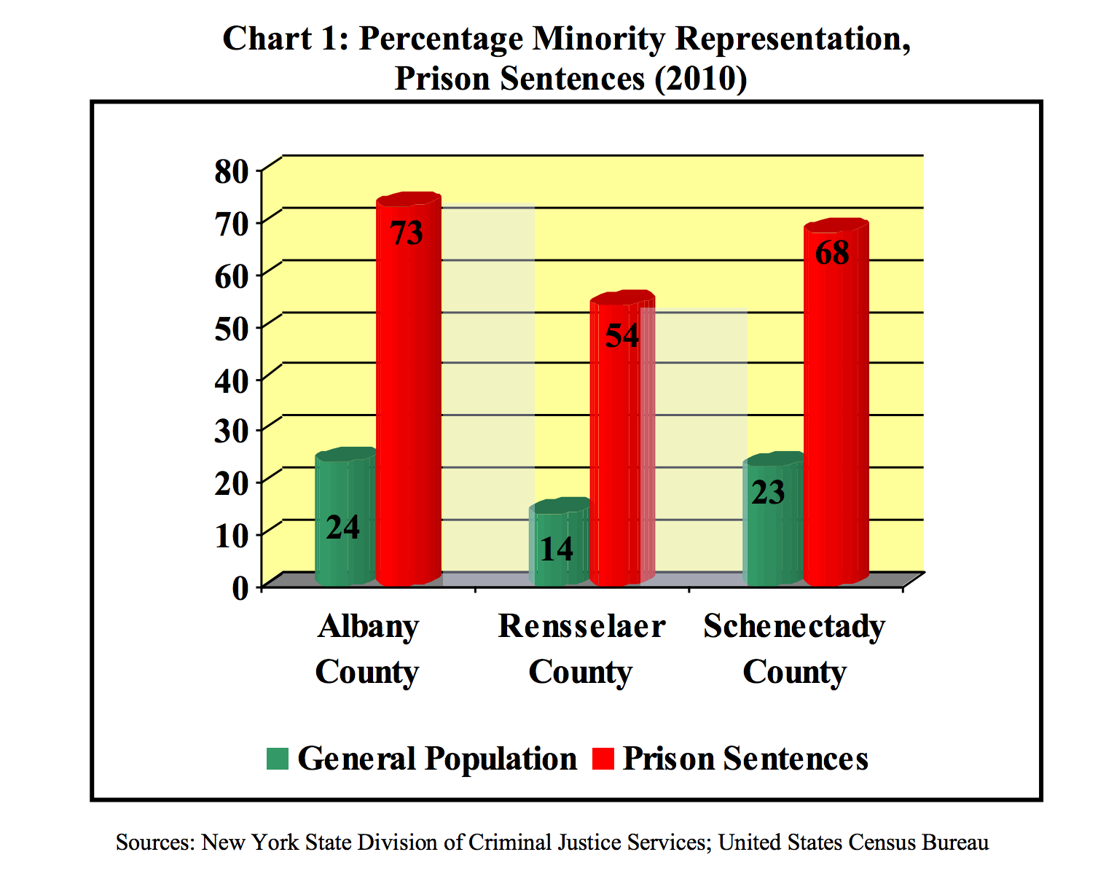
Source: Center for Law, Order & Justice report (2012): “The disproportionate impact of the
criminal justice system on people of color in the Capital Region.”
Notes:
Source: Center for Law, Order, & Justice report (2012)

Slide 38
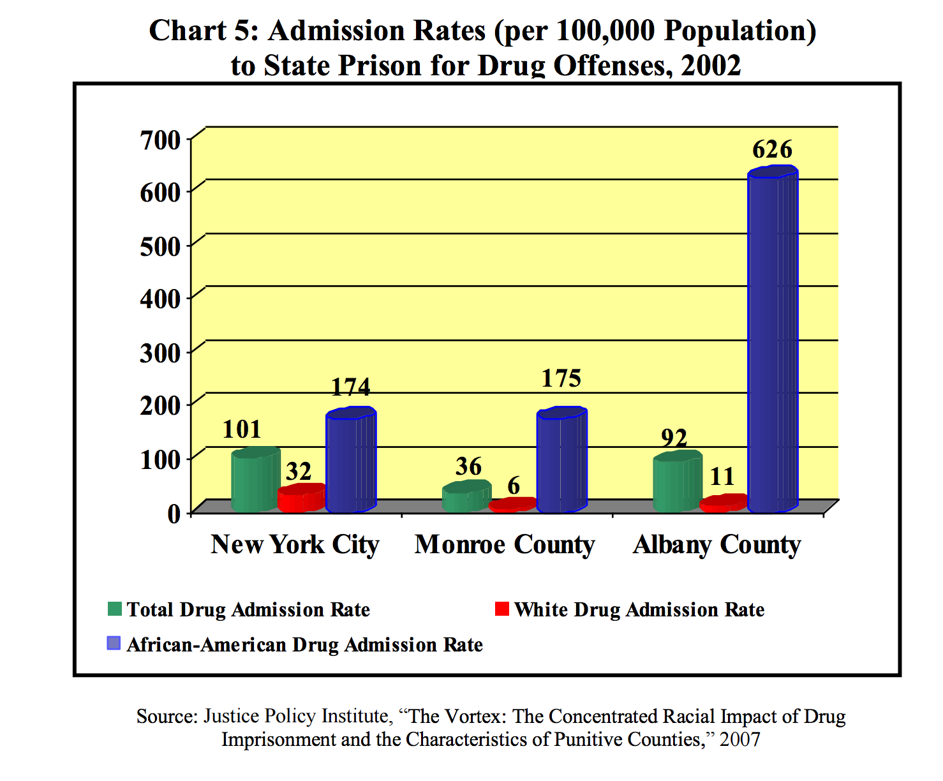
Source: Center for Law, Order & Justice report (2012): “The disproportionate impact of the
criminal justice system on people of color in the Capital Region.”
Notes:
Source: Center for Law, Order, & Justice report (2012)

Slide 39
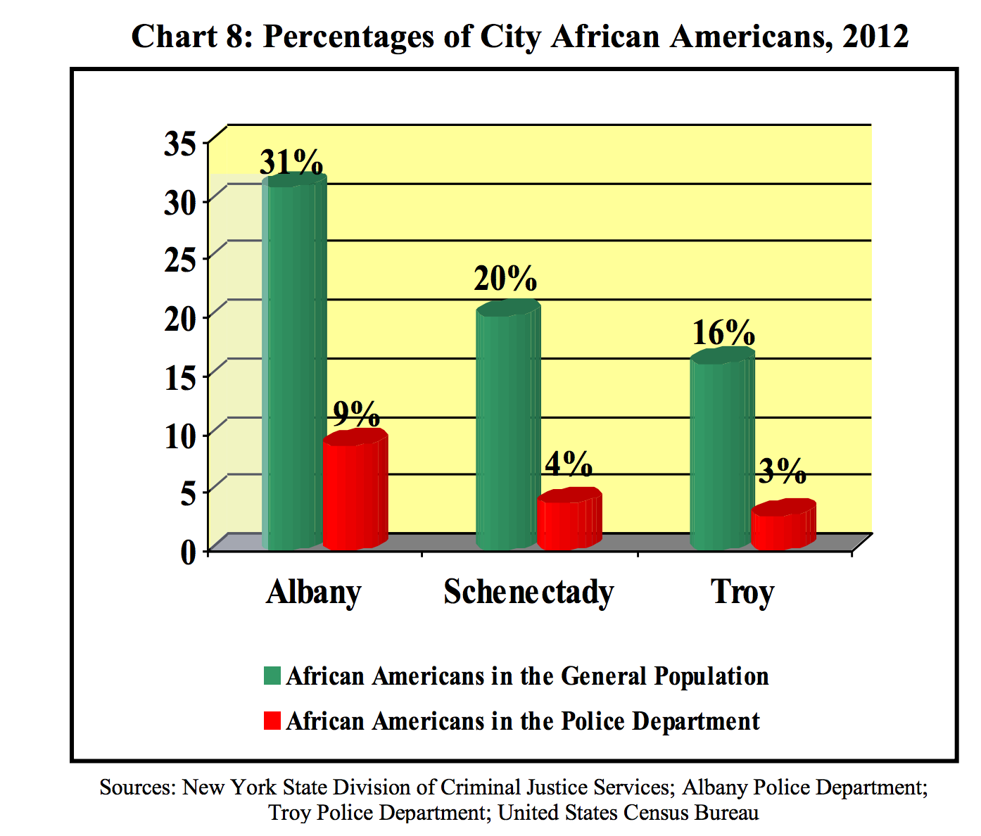
Source: Center for Law, Order & Justice report (2012): “The disproportionate impact of the
criminal justice system on people of color in the Capital Region.”
Notes:
Source: Center for Law, Order, & Justice report (2012)

Slide 40
Some scholars say that
“Imprisonment now creates far more crime than it prevents, by ripping apart fragile networks, destroying families, and creating a permanent class of unemployables.”

Slide 41
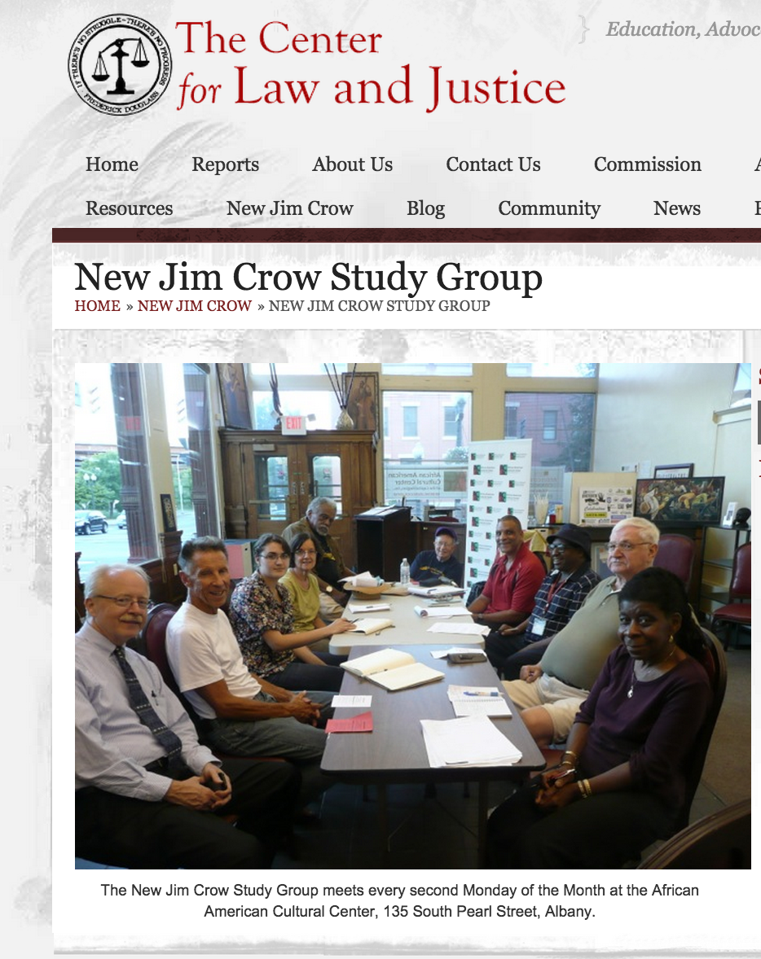

Slide 42
Community Fathers another great community force for good, helping newly released prisoners reconnect with their family responsibilities.
Girls Inc (located in Hamilton Hill) has programs to support and encourage young women.
YWCA has domestic violence programs.
Kenney Center can connect you with all these great community programs and more!

Slide 43
Community grass roots efforts are great—are they enough?
What else can/should we do or consider doing to redress inequality?

