Slide 1
Income and Wealth Inequality in the U.S. Causes and Consequences
Eshragh Motahar
Fall 2016

Slide 2
Introduction
What do we mean by inequality
Income (pre-tax, post-tax), Wealth
Is it inevitable
Historical context
What is new?
Why should we care about it
Policies

Slide 3
Book published in Spring 2014
Capital in the Twenty-First Century
Piketty mania: how an economics lecture became the hottest gig in town
http://www.theguardian.com/books/2014/jun/17/thomas-piketty-lse-capitalism-talk

Slide 5
Pikettymania
A specter is haunting Europe and the U.S.—the specter of plutocracy. In Britain, Deputy Prime Minister Nick Clegg has suggested the moment has arrived to consider a wealth tax. In France, which already has one, plans to ease its bite were recently canceled. Even in the more timid precincts of Washington, you cannot swing a V for Vendetta mask without hitting a think tank panel on inequality. Everyone, it seems, is worried we are shortly headed for a world in which a handful of rich people will own everything, and the rest are forced to rent their air and water from Mark Zuckerberg.
http://www.businessweek.com/printer/articles/204120-pikettys-capital-an-economists-inequality-ideas-are-all-the-rage

Slide 6
The “Piketty Graph”

Slide 7
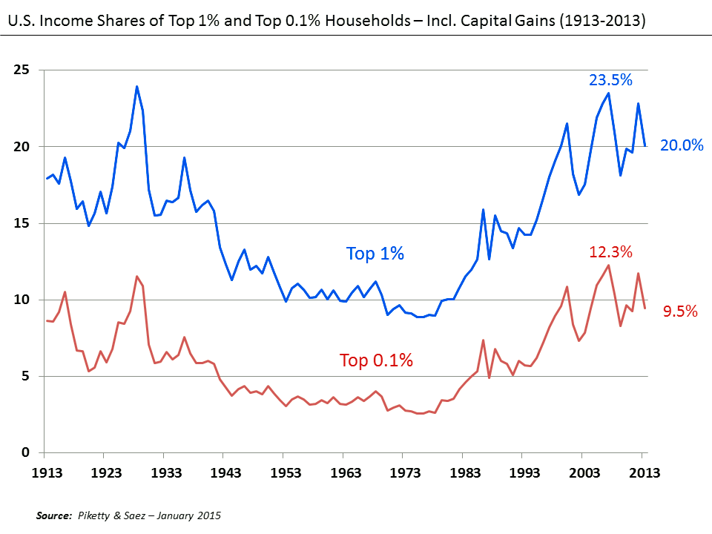
Piketty Graph (2)

Slide 8
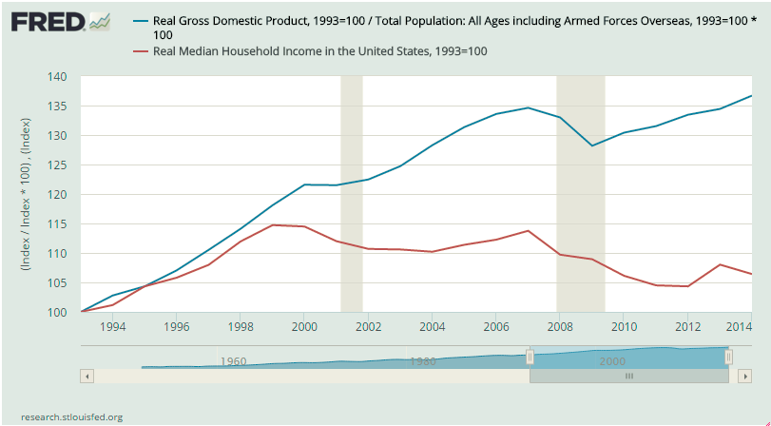

Slide 9
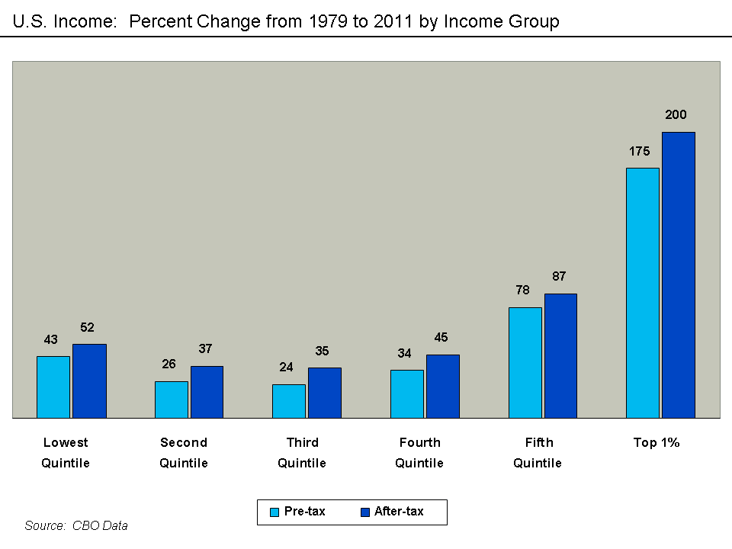

Slide 10
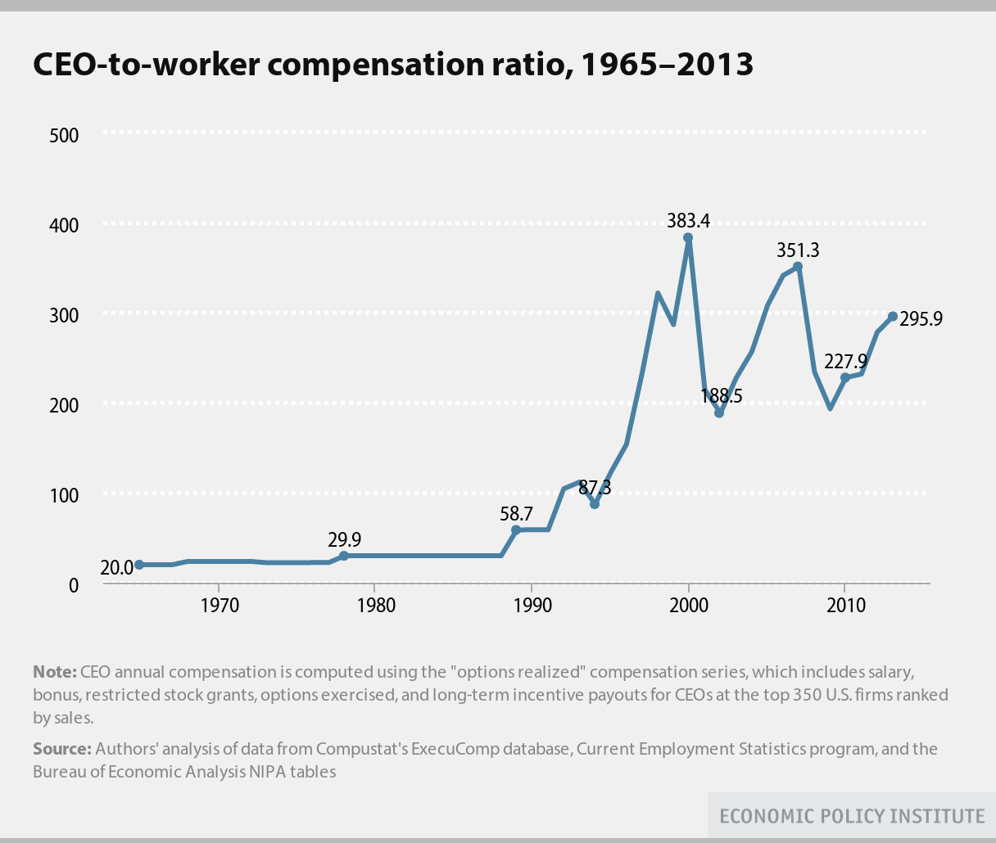

Slide 11
CEO Pay
These U.S. CEOs Make a Lot More Money Than Their Workers
http://www.bloomberg.com/news/articles/2015-08-13/these-ceos-make-the-most-money-compared-with-their-workers
Average CEO pay at the 350 largest U.S. companies by revenue surged 997 percent from 1978 to 2014, while the compensation of non-supervisory employees rose 10.9 percent, according to the Economic Policy Institute.

Slide 12
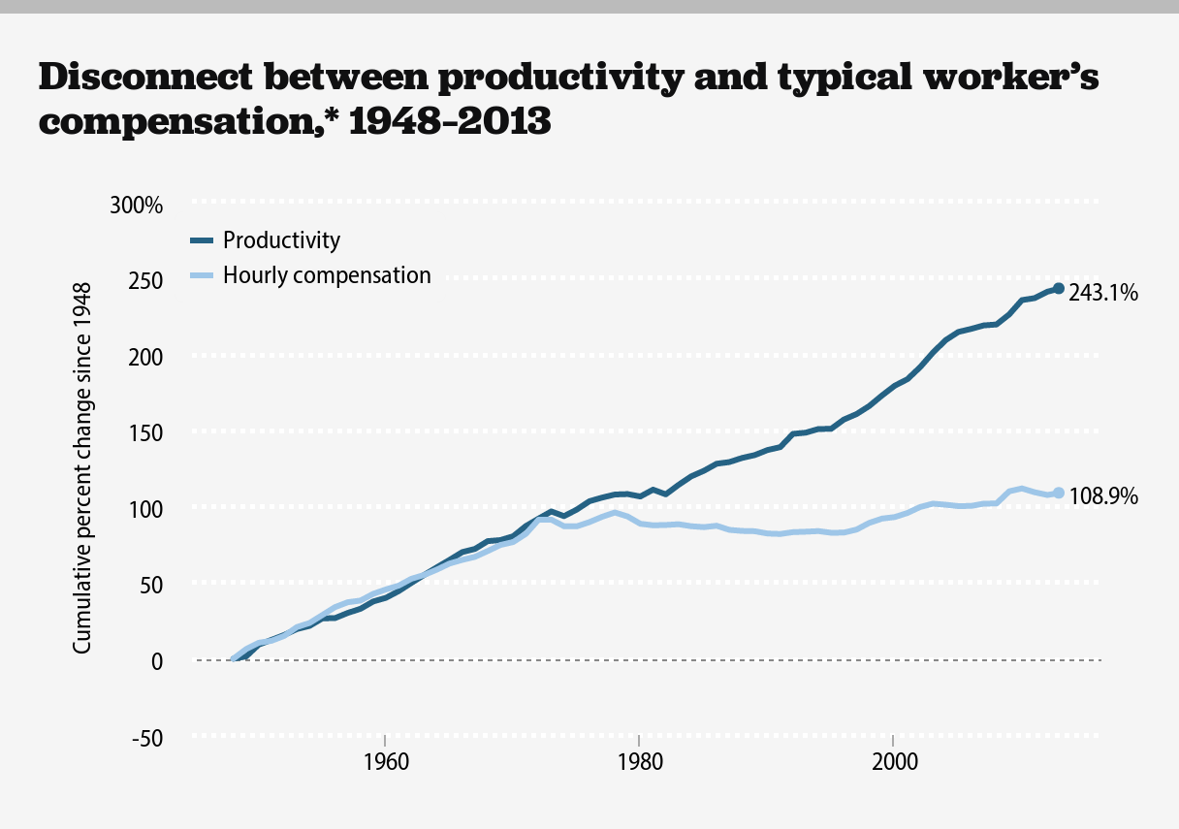

Slide 13
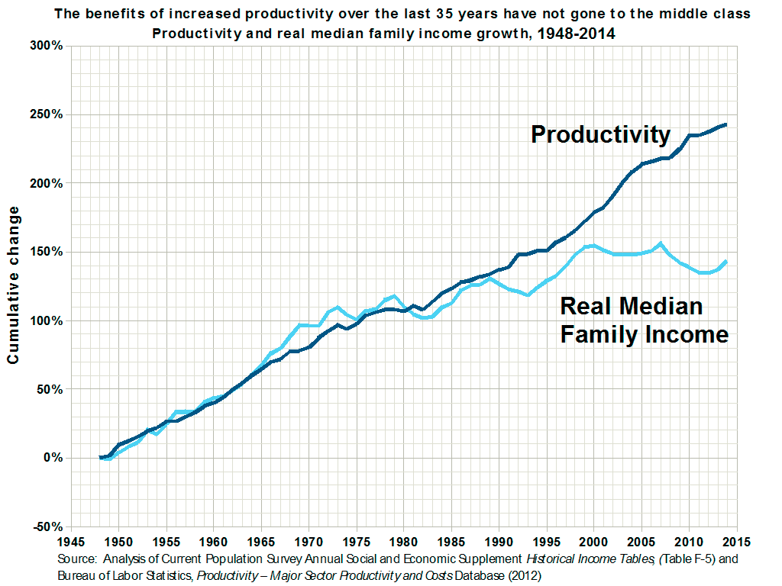

Slide 14
Income and Wealth Disparity
The Gini Coefficient measures how equally distributed resources are, on a scale from 0 to 1. In the case of 0, everyone shares all resources equally, and in a society with a coefficient of 1, a single person would own everything. While income in the U.S. is distributed unequally, with a .574 gini, wealth is distributed far more unequally, with a gini of .834 — and financial assets are distributed with a gini of .908, with the richest 10 percent own a whopping 83 percent.
Source: The myth destroying America: Why social mobility is beyond ordinary people’s control
Americans overwhelmingly believe they control their financial destinies, but a huge body of research says otherwise
Sean McElwee. Saturday, Mar 7, 2015. http://www.salon.com/2015/03/07/the_myth_destroying_america_why_social_mobility_is_beyond_ordinary_peoples_control/

Slide 15
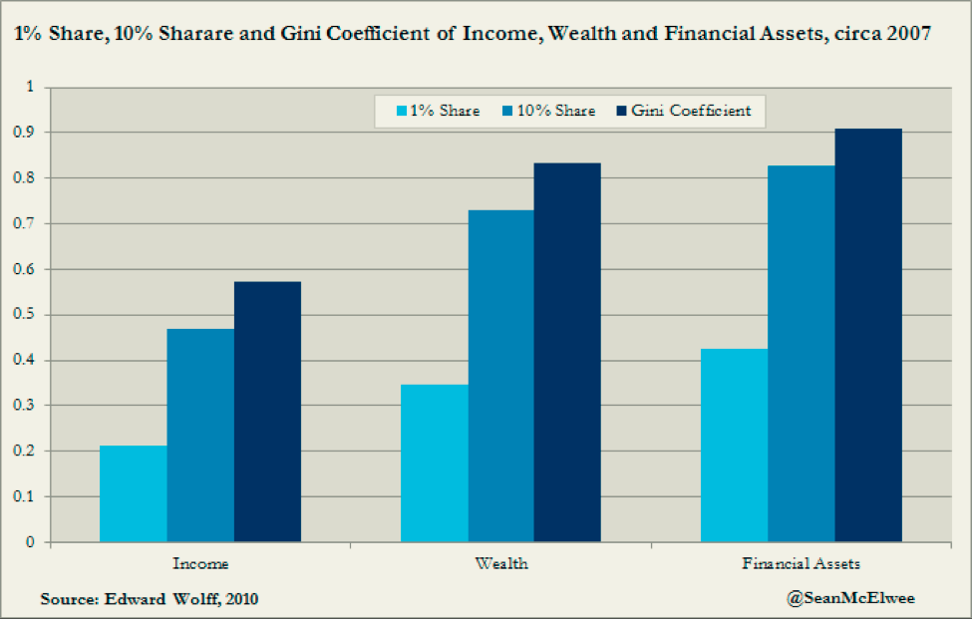
Income and Wealth Disparity

Slide 16
Social Mobility
A 2007 Treasury Department study of inequality allows us to examine mobility at the most elite level. On the horizontal axis (see below) is an individual’s position on the income spectrum in 1996. On the vertical level is where they were in 2005. To examine the myth of mobility, I focused on the chances of making it into the top 10, 5 or 1 percent. We see that these chances are abysmal. Only .2 percent of those who began in the bottom quintile made it into the top 1 percent. In contrast, 82.7 percent of those who began in the top 1 percent remained in the top 10 percent a decade later.

Slide 17
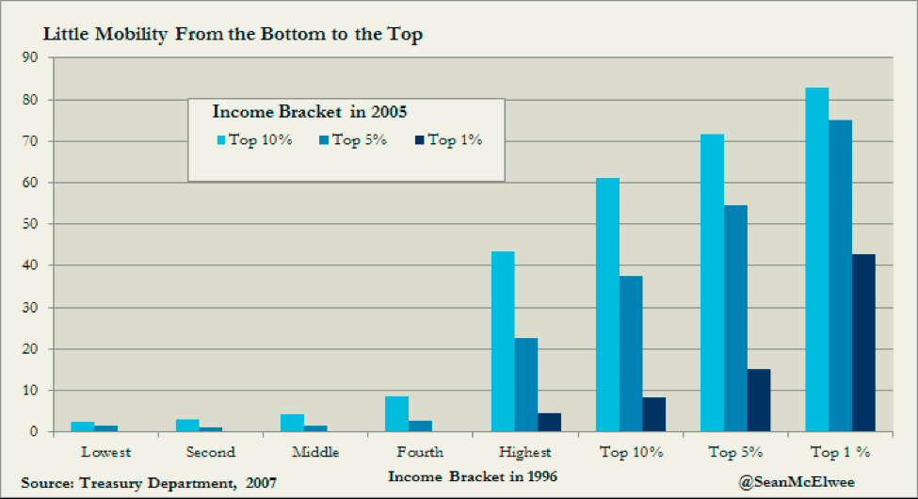
Social Mobility

Slide 18
Several studies have indicated that higher income inequality corresponds with lower income mobility. In other words, income brackets tend to be increasingly "sticky" as income inequality increases. This is described by a concept called the Great Gatsby curve.

Slide 19
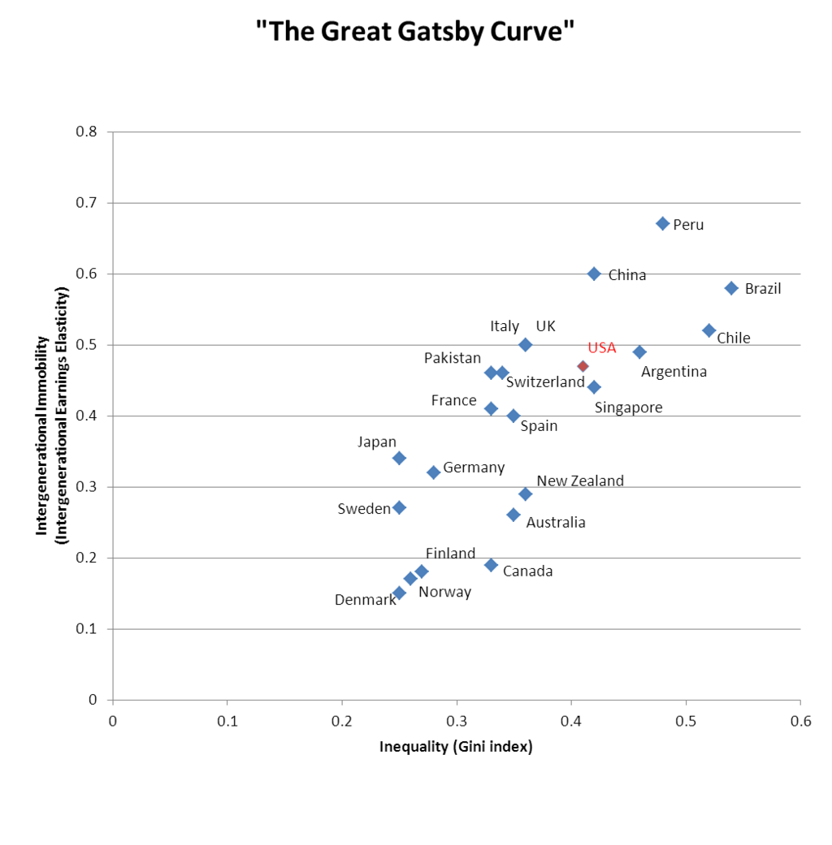
The Great Gatsby Curve

Slide 20
In summary, as of now (in approximate numbers)…
The top 1%
is taking home more than 20% of total income
Owns at least 38% of total wealth
The richest 400 people in the U.S. have more wealth than the bottom 150 million Americans put together
CEOs of large corporations now earn 300 times wages of average workers (vs. 35-40 times in 50s-60s)

Slide 21
The retirement savings accumulated by just 100 chief executives are equal to the entire retirement accounts of 41 percent of U.S. families -- or more than 116 million people, a new study finds. [Bloomberg, 2015]
The combined wealth of the richest 1 percent will overtake that of the other 99 percent of people by 2016. [Oxfam, 2015]

Slide 22
Causes
Pre-tax
Globalization, Trade Policy
Skill-bias technological change
Declining union power
Stagnant minimum wage
Financialization
Post-tax
Tax laws
Slashing welfare
“Neo-liberalism”

Slide 24
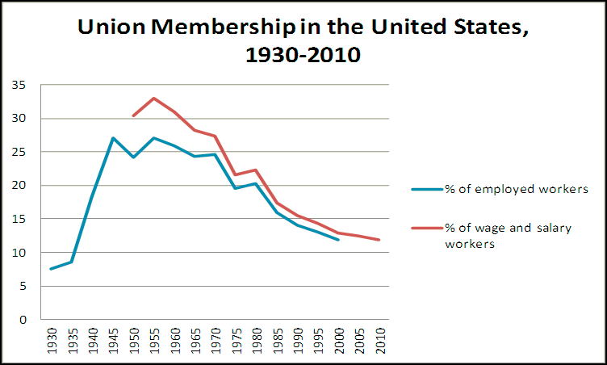

Slide 28
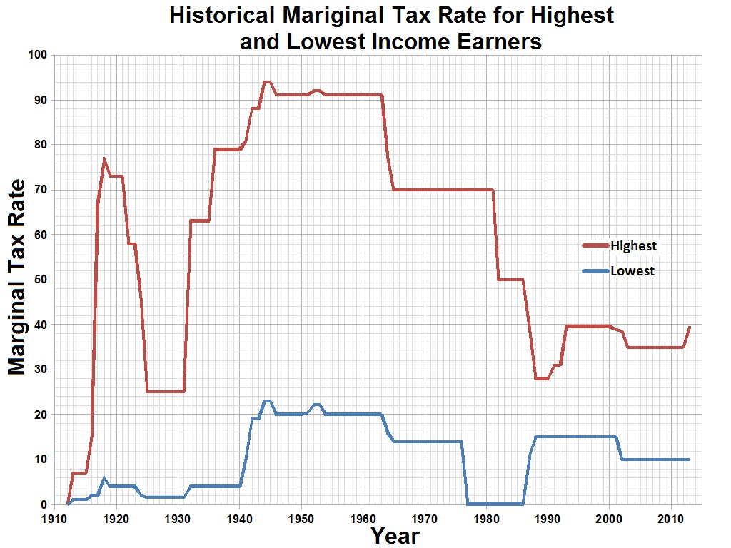

Slide 30
Piketty’s Contributions
The truly rich—top 1% [making it “visible”]
Inheritance
“we’re … on a path back to “patrimonial capitalism,” in which the commanding heights of the economy are controlled not by talented individuals but by family dynasties.”
“It’s a work that melds grand historical sweep—when was the last time you heard an economist invoke Jane Austen and Balzac?—with painstaking data analysis.”

Slide 31
Piketty’s Contributions (2)
Income from capital vs. earned income (wages and salaries)
Unequal ownership of assets, not unequal pay, is the prime driver of income disparities
A good diagnosis is important if one is looking for remedies.

Slide 32
Why does it matter?
“Patrimonial capitalism”
Inequality of opportunity
Oligarchy
Lower growth (MPC differentials, etc.)
More unstable economy: financial crises/deflation
Reduced income mobility
Higher levels of household debt
Political/policy dimensions
Disequilibrium dynamics

Slide 33
Is U.S. becoming an Oligarchy?
“Fewer than four hundred families are responsible for almost half the money raised in the 2016 presidential campaign, a concentration of political donors that is unprecedented in the modern era.”
The New York Times, August, 2015

Slide 34
Proposed Policies
Policy matters (compare the U.S. with Sweden, Japan, France)
The ideal solution: progressive wealth tax at the global scale, based upon automatic exchange of bank information
Widely accessible education and healthcare (human capital)
Trade deals
Minimum wage

Slide 35
Conclusion
Growth outlook
Debt burden
Several other challenges
Prospects for policy changes

Slide 36
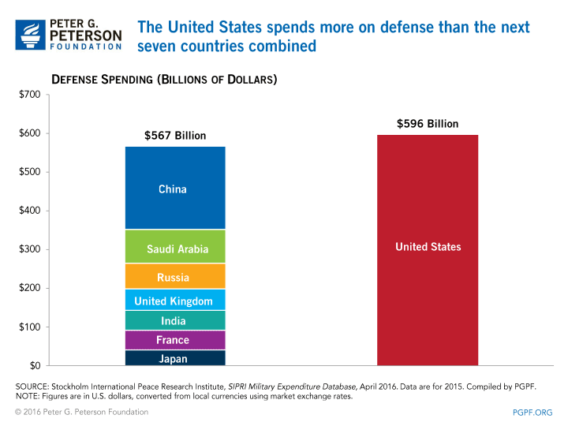

Slide 37
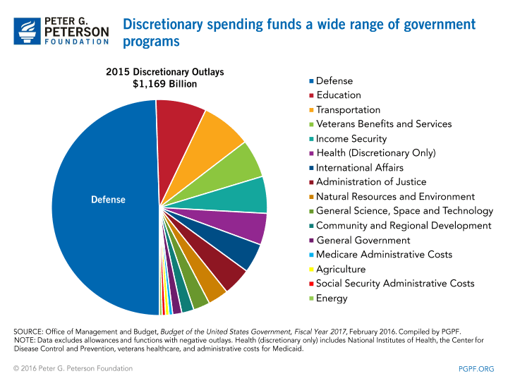

Slide 38
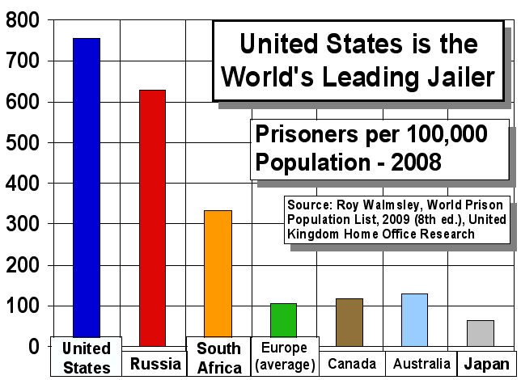
Incarceration Rate per 100,000 Population

Slide 39
Scholarly Sources (1)
IMF study finds inequality is damaging to economic growth
International Monetary Fund paper dismisses the argument that redistributing incomes is self-defeating

Slide 40
Scholarly Sources (2)
We use consumption and balance sheet data disaggregated between the top 5% and the bottom 95% of US households by income to show that the bottom 95% went deeply into debt to mitigate the impact of their stagnant incomes on their consumption. We use micro data to calibrate an intrinsic Keynesian growth model and show that over a range of plausible parameter values, the rise in US household income inequality increased enough between the early 1980s and 2000s to cause the entire magnitude of the Great Recession and can explain the slow and prolonged recovery.
* Authors Cynamon: Visiting Scholar at the Federal Reserve Bank of St. Louis Center for Household Financial Stability; Fazzari: Departments of Economics and Sociology at Washington University in St. Louis.

Slide 41
…. and even
Income Inequality Hurts Economic Growth

Slide 42
Weak Recovery

Slide 43
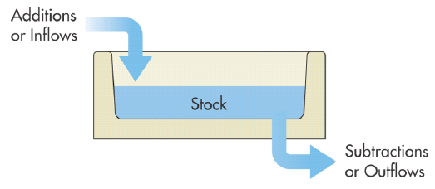
Some Key Concepts
Income (flow)
Wealth (stock)

Slide 44
The T-shirt http://shop.comedycentral.com/The-Colbert-Report-r-g-Tee/M/B00KQ2T9KY.htm

Slide 45
r vs. g
r rate of return on capital
g rate of growth of income
If r > g, then the ratio of capitalist’s wealth to worker’s wage increases at an annual rate of r – g
Thus r > g can be regarded as an “amplification mechanism” for existing inequalities, including labor income inequalities

Slide 46
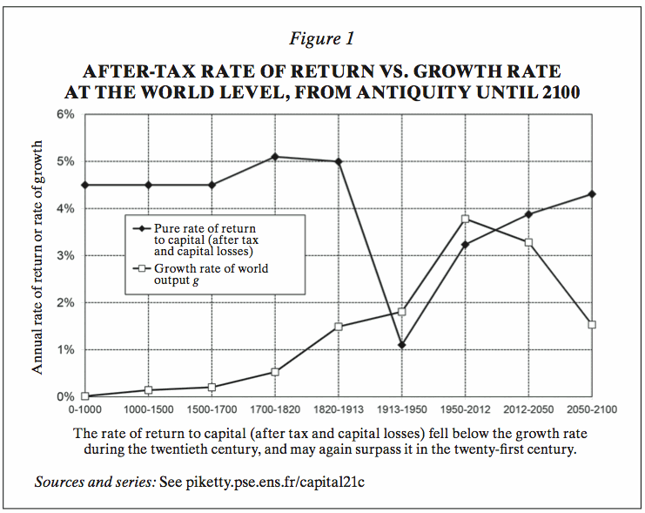

Slide 47
Piketty’s Numerical Estimates
r = 4-5%
g = 1.5
Thus, r – g = 3%

Slide 48
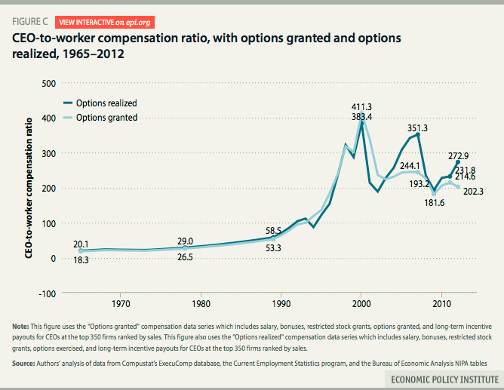
CEO Pay

Slide 49
CEO Pay
Money to Burn: How CEO Pay is Accelerating Climate Change
IPS: http://www.ips-dc.org/wp-content/uploads/2015/09/EE2015-Money-To-Burn-Upd.pdf

Slide 50
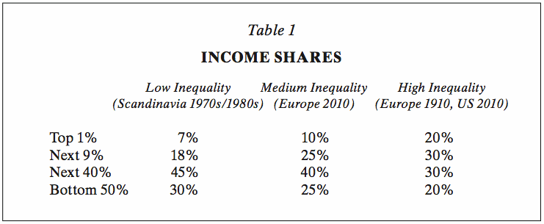

Slide 51
Piketty Graph

Slide 52
Trump (1)
"The average Republican voter isn't rich (although upper-income voters do tend to lean Republican). So why are they handing the braggart billionaire the top spot in national and most state polls? It's because Trump's financial success is seen as a moral good by conservative activists. Nigel Barber, an evolutionary psychologist, explains that conservatives admire wealth because successful people are seen as having worked hard in pursuing a moral obligation to provide for themselves and their families in a difficult and uncertain world. As economist Tyler Cowen notes, conservatives often believe that much of the poverty in the United States is an issue of insufficient disciplined and conscientiousness. In this worldview, Trump's wealth represents a sort of admirable discipline one that stands far apart from his bombastic rhetoric that much of the rest of America defines him with. Some social psychologists say it could be that conservatives endorse existing patterns of group dominance because they honestly believe that society operates in a reasonably meritocratic fashion. In that hierarchy, Trump is the most meritocratic candidate. After all, he has the most money, and he won't shut up about it. GOP voters are loving it." Here

Slide 53
Trump (2)
“Trump was born in New York City in 1946, the son of real estate tycoon Fred Trump. Fred Trump’s business success not only provided Donald Trump with a posh youth of private schools and economic security but eventually blessed him with an inheritance worth an estimated $40 million to $200 million. It is critical to note, however, that his father’s success, which granted Donald Trump such a great advantage, was enabled and buffered by governmental financing programs. In 1934, while struggling during the Great Depression, financing from the Federal Housing Administration (FHA) allowed Fred Trump to revive his business and begin building a multitude of homes in Brooklyn, selling at $6,000 apiece. Furthermore, throughout World War II, Fred Trump constructed FHA-backed housing for US naval personnel near major shipyards along the East Coast.” More here.

Slide 54
Some Relevant Sites
http://topincomes.parisschoolofeconomics.eu/#Graphic:
http://www.gc.cuny.edu/Page-Elements/Academics-Research-Centers-Initiatives/Centers-and-Institutes/Luxembourg-Income-Study-Center
http://inequality.org/
http://scalar.usc.edu/works/growing-apart-a-political-history-of-american-inequality/index

Slide 55
Graphs
Piketty on the U.S. (in one graph)
http://scalar.usc.edu/works/growing-apart-a-political-history-of-american-inequality/index
Other indicators
[scroll down]

Slide 56
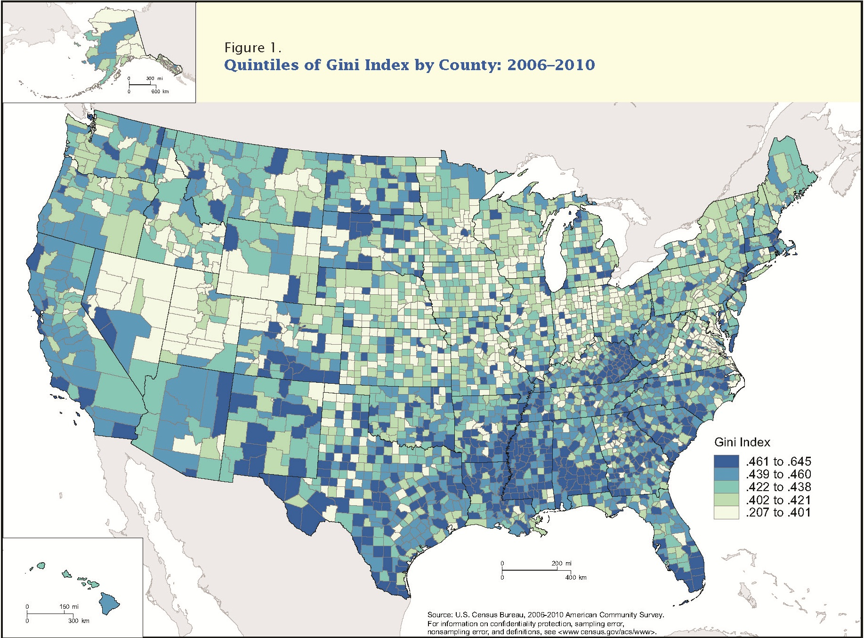

Slide 57
