Slide 1
Sense and Sensibility:
Patriarchy and Primogeniture

Slide 2
Tonight’s key concepts:
Inheritance (I) and Patriarchy (II)
How do inheritance and patriarchy construct and perpetuate inequality?
Jane Austen’s Sense and Sensibility: a social satire showing how institutions reward greed, selfishness, mediocrity

Slide 3
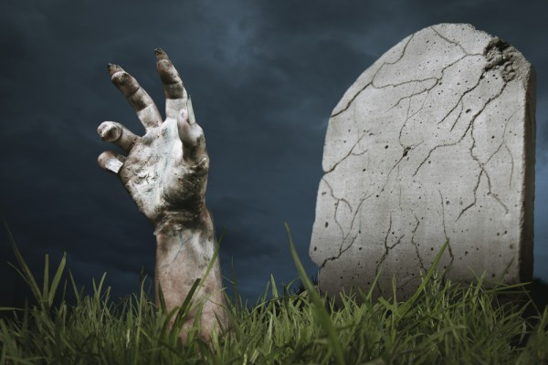
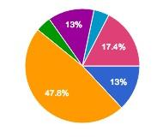
Section I: Inheritance
“The pen is a long arm from the grave.”
--James Clavell, Sho-Gun
Survey Results
3 - leave it all to my spouse
0 - leave it all to the eldest son
11 - leave it all to my children, divided evenly
1 - leave it all to the child or children who represents my moral values
3 - leave it all to my grandchildren, divided evenly
1- leave it all to charity
4 - spend or donate it all before I die
Inheritance choices (and laws) are constructs: they reflect and reinforce fundamental values

Slide 4
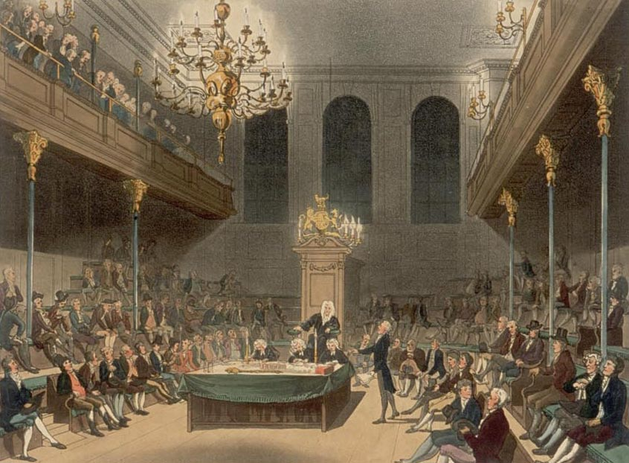
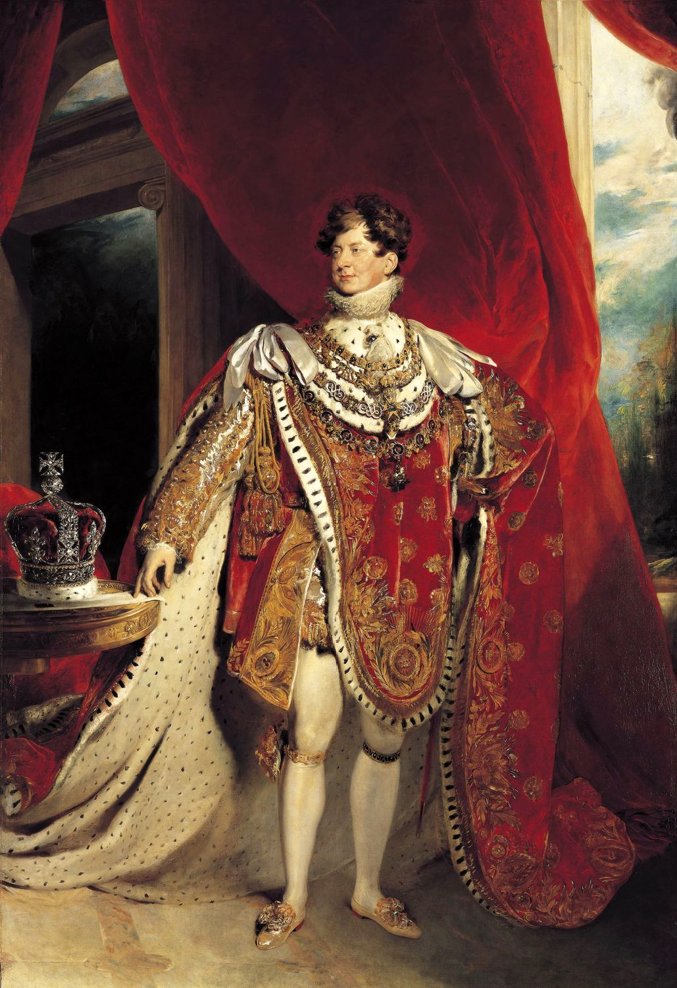
Austen’s England: Monarchy, Landed Aristocracy
Austen: 1775-1818
House of Commons, Regency Era

Slide 5
“Huge Tracts of Land…”
Landed Aristocracy: descendants of royalty (sometimes very distant), AND non-descendants granted titles and lands by the king. Income from invested fortunes, and/or from estates.
Peers: Duke, Marquess, Earl, Viscount, Lord/Baron
Landed Gentry: Baronet, Knight, Esquire, Gentleman
S&S Examples: Sir John Middleton, Mr. Henry Dashwood, Lord Morton
Acceptable professions: clergyman, politician, army/navy
Income/Wealth from business = “In Trade” = “vulgar”

Slide 6
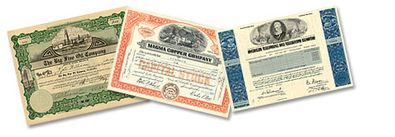
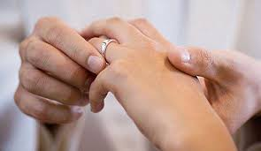
Peers and Gentry: Making Ends Meet
TTjhhSomS
Cash and Investments (stocks, bonds): usually a rate of 4 to 5 % annual return (passive income)
Estates produce income (managed by your steward):
renting houses, shops, fields
income from farming (crops and wool), timber, minerals, fish, game
income from lands held abroad
Marrying money:
Men’s fortunes expressed in yearly income (sum of estate and investment income): f/e “five thousand a year...ten thousand a year”
Women’s fortunes (daughters of peers and gentry) expressed as a lump sum they bring to the marriage: f/e “Miss Grey has fifty thousand pounds.” (Generates interest income.)
Estate in trouble? Sell land, mortgage land, turn away some servants, rent out your house and live elsewhere, marry money

Slide 7
Wages, Capital, Financial Independence
Annual Wages $50,000
(earned income)
$1M capital @ 5% = $50,000 annual (passive) income
after taxes | $35,000
expenses | $25,000
savings! | $10,000
after taxes | $35,000
expenses | $25,000
savings! | $10,000
savings can be invested, given away...
savings can be invested, given away...
after taxes | $35,000
expenses | $45,000
DEBT!!! | $10,000
after taxes | $35,000
expenses | $45,000
subtr. from capital* | $10,000
*your capital now only worth $990,000

Slide 8
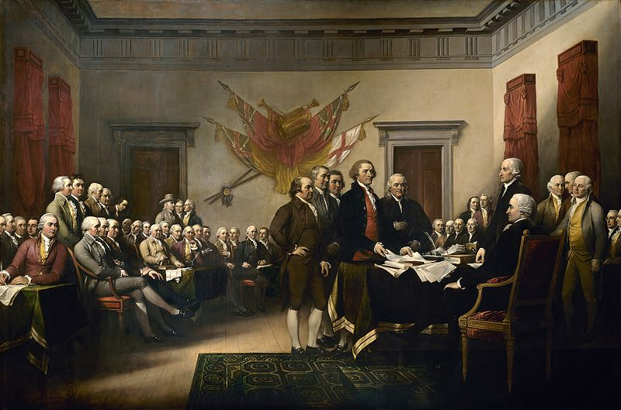
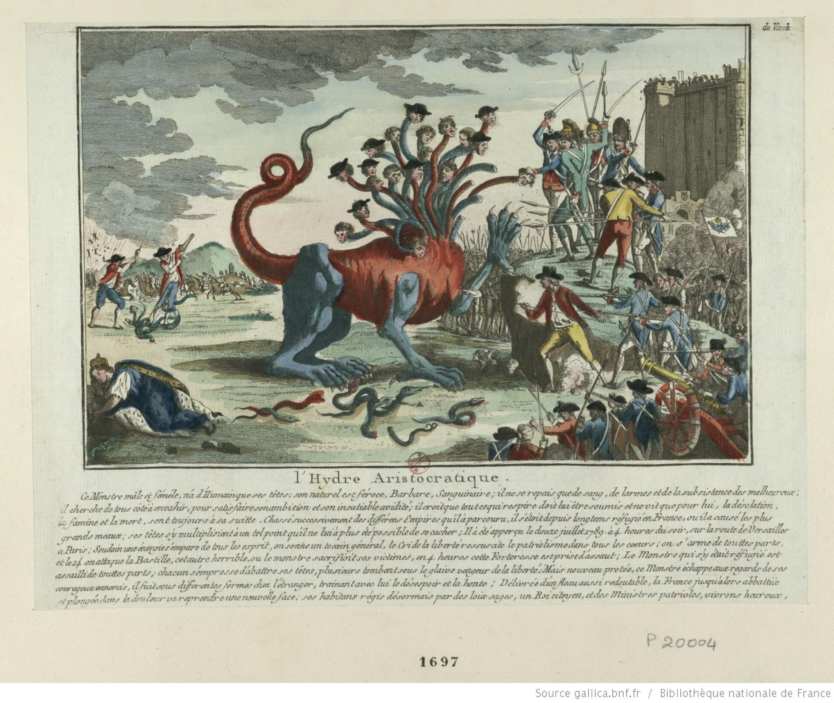
Challenges to Monarchy and Aristocracy in Austen’s Life (1775-1818)
1789
1804
1776

Slide 9
Aristocracy: Burke vs. Paine
Edmund Burke, Reflections on the Revolution in France (1790)
In favor of aristocracy and primogeniture. Rhetorical strategies:
Thomas Paine, The Rights of Man (1791)
Opposes (Burke and) aristocracy and primogeniture. Rhetorical strategies:

Slide 10
English Legal Terms: Inheritance
Primogeniture (n): the family estate (and any title) goes to the oldest son. Customary but not obligatory.
Entail (n): limits the passage of a landed estate to a specified line of heirs, so that it cannot be alienated, devised, or bequeathed. Requires an Act of Parliament to change it.
Austen gives us two models of parental control over an estate: one with, one without

Slide 11
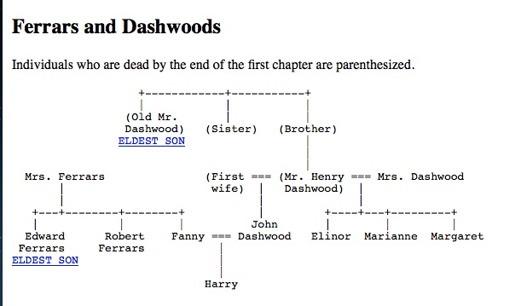
Sense and Sensibility: Two Families

Slide 12
Primogeniture and Entail: Model 1
Dashwood Family:
Primogeniture. Norland Park descends to the oldest male child.
Entail takes away parental control. Mr. Henry D. cannot alter the inheritance to help his wife and daughters.
RESULT: INEQUALITY

Slide 13
John and Fanny Dashwood:
Mr. and Mrs. Moneybags
(average British income) | (30 pounds/yr) | ($2400/yr in today’s dollars)
inheritance from mother | unspec; ~ 5000 pounds/yr | $400,000/yr
Fanny’s dowry | 10,000 pounds; interest income 500 pounds/yr | $ 40,000/yr
Norland estate income | 4000 pounds/yr | $320,000/yr
TOTAL | 9500 pounds/yr | $780,000/yr
projected gift to sisters (never given) | 3000 pounds = 150 pounds/yr interest income | $12,000/yr (see Chapter II)
Total net worth: 9500 * 20 = 190,000 * 80 = ~ $15,600,000

Slide 14
Expenses in Austen’s life
460 pounds/yr | Annual income of Austen, her mother, and sister after her father’s death | $36,800/year
200-300 pounds/yr | bare minimum annual income for “genteel” non-working status (per person) | $24,000/year
140 pounds | Austen’s total profit on Sense and Sensibility (first ed.) | $11,200
110 pounds | The sum for which Austen sold the copyright to Pride and Prejudice | $8800
40 pounds/yr | Austen’s spending allowance from her father (for clothing and misc expenses) | $400 per quarter

Slide 15
The Dashwood Women:
Clinging to Gentle Status
150 pounds/yr | Interest income from 1000 pounds left to each daughter by Old Mr. Dashwood | $12,000/year
500 pounds/yr | Dashwood women’s total income (they also employ and feed two servants) | $40,000/year
200 pounds/yr | Edward Ferrars’ living (clerical job) at Delaford parish | $16,000/year
50 pounds/yr | Elinor Dashwood’s interest income from her 1000 pound inheritance | $4000/year
500 pounds/yr | Interest from 10,000 lump sum given Edward by his mother on his marriage | $40,000/year
2000 pounds/yr | Colonel Brandon’s income from Delaford estate | $160,000/year

Slide 16
Primogeniture and Entail: Model 2
Ferrars Family:
Primogeniture, but no entail -- initially. The widowed Mrs. Ferrars has control over what and when her children inherit.
She entails the estate on Robert instead of Edward.
Primogeniture is overthrown.

Slide 17
Questions for Discussion
What solution, if any, does Austen propose to the inequalities caused by primogeniture?
To what extent does Austen agree or disagree with Burke and/or Paine?

Slide 18
Section II: Patriarchy, or,
Why can’t Elinor and Marianne just get jobs?
Patriarchy (n): literally, “rule by fathers.”
a system of society or government in which the father or eldest male is head of the family and descent is traced through the male line.
a system of society or government in which men hold the power and women are largely excluded from it.

Slide 19
How to create inequality
Set yourself up as the norm
Construe difference as “abnormality”
(Self vs. Other)
Construe “abnormality” as “inferiority”
Use “inferiority” to justify inequality
Repetition leads to internalization

Slide 20
Misogyny: Wellspring of patriarchy
Female Inferiority = Woman as Other
physical inferiority
moral/spiritual inferiority
intellectual inferiority
Repetition leads to internalization

Slide 21
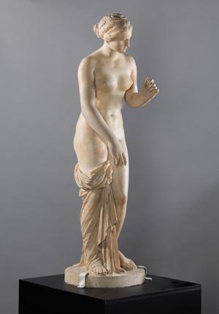
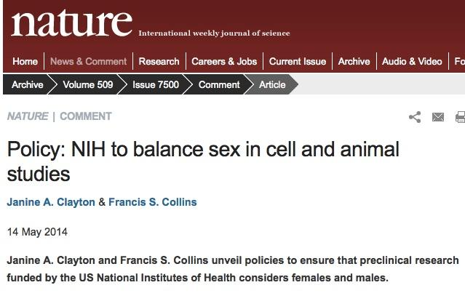
Ancient Medicine: The Male Norm
Aristotle (d. 322 B.C.E.): “A woman is as it were a deformed male…[who] lacks the power to concoct semen...The female always provides the material, the male provides the form. The physical part, the body, comes from the female,and the Soul from the male.”

Slide 22
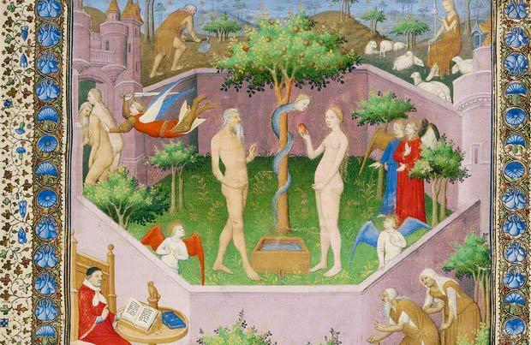
Medieval Christianity: Woman as Eve
Tertullian (d. 225 C.E.): “You are the gateway of the devil….You easily destroyed the image of God, Adam….In order to achieve perfect, that is, Christian chastity, you must not only not seek to be the object of desire, but despise the very idea of being one. First, because the desire to please through appearance does not come from a sound conscience, since we know that appearance naturally excites sexual desire. Why therefore do you arouse this evil towards yourself?”
From the Everyday Sexism Project: “I got dress coded at my school for wearing shorts. After I left the principal’s office with a detention I walked past another student wearing a shirt depicting two stick figures: the male holding down the female’s head in his crotch and saying ‘good girls swallow’. Teachers walked right past him and didn’t say a thing.” (Time, May 22, 2015, “How School Dress Codes Shame Girls and Perpetuate Rape Culture”)

Slide 23
The Female Mind: Education
Hester Chapone, Letters on the Improvement of the Mind, Addressed to a Young Lady, (1820) Letter VIII:
What makes a woman “useful and pleasing to her fellow-creatures”?
Christian virtues: piety, benevolence, meekness, humility, integrity, and purity
Domestic skills: managing servants, raising children, living within one’s means
Accomplishments: French, Italian, dancing, art/music, poetry, history, biography, basic arithmetic, writing
“The attainment of such branches of knowledge and such arts and accomplishments ...will prove so valuable to yourself and make you so desirable a companion, that the neglect of them may reasonably be deemed a neglect of duty.”

Slide 24
Hester Chapone, continued
“As to the learned languages, though I respect the abilities and application of those ladies who have attained them, and who make a modest and proper use of them, yet I would by no means advise you—or any other woman who is not strongly impelled by a particular genius—to engage in such studies. The labour and time which they require are generally incompatible with our natures and proper employments: the real knowledge which they supply is not essential, since the English, French, or Italian tongues afford tolerable translations of all the most valuable productions of antiquity, besides the multitude of original authors which they furnish: and these are much more than sufficient to store your mind with as many ideas as you will know how to manage. The danger of pedantry and presumption in a woman—of her exciting envy in one sex and jealousy in the other—of her exchanging the graces of imagination for the severity and preciseness of a scholar, would be, I own, sufficient to frighten me from the ambition of seeing my girl remarkable for learning. Such objections are perhaps still stronger with regard to the abstruse sciences.”
Repetition leads to internalization

Slide 25
The Female Mind: “Sensibility”
Early Romantic notion, in reaction against Enlightenment values of rationality, self-control, distrust of emotions, trust in social mores as regulators of innate human selfishness and vice, emphasis on civility and duty to others (Elinor)
Sensibility: being open to emotion, disdain for conventional behavior and social mores (such as civility and duty to others), as a restraint on innate human goodness and virtue (Marianne)
Both sisters suffer similar setbacks; Marianne bears them badly and makes herself severely ill, must learn self-control and rationality

Slide 26
Dissenting voices:
Mary Wollstonecraft
A Vindication of the Rights of Women (1792)
parallel between women and non-aristocrats, p. 286
consequences of weak female education, pp. 288-9

Slide 27
Textual Analysis: Chapter II
Plus film version of Austen’s brilliant Chapter II

Slide 28
Questions for Discussion
What solution, if any, does Austen propose to the inequalities perpetuated by patriarchy?
To what extent does Austen agree or disagree with Wollstonecraft or Chapone?

