Slide 1
The Structure of a Balance Sheet
Eco 242

Slide 2
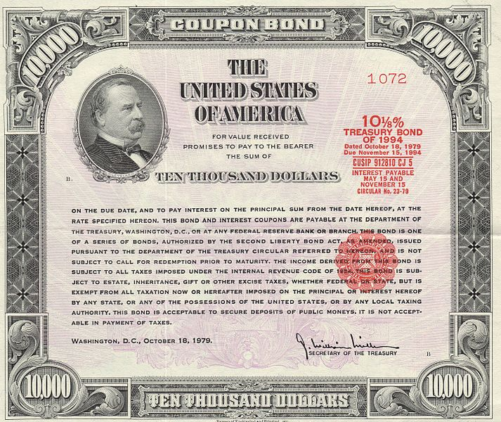

Slide 3
Alice I. Wonderland
Assets
Liabilities
House $350
Treasuries $150
Checking Account $10
Savings Account $15
Stamp Collection $5
Car $20
TOTAL $550
Mortgage $300
Credit Card $50
Car Loan $15
Personal Loan $85
Net Worth $100
TOTAL $550

Slide 4
Alice I. Wonderland
Assets
Liabilities
House $350
Treasuries $50
Checking Account $110
Savings Account $15
Stamp Collection $5
Car $20
TOTAL $550
Mortgage $300
Credit Card $50
Car Loan $15
Personal Loan $85
Net Worth $100
TOTAL $550

Slide 7
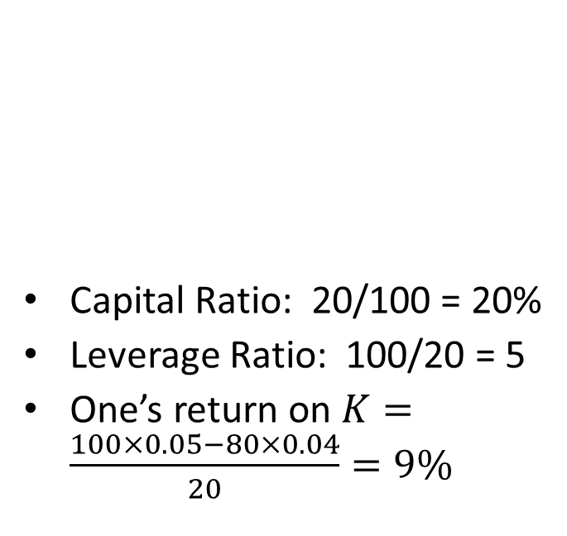
Leverage
Bank One
Bank Two
Capital Ratio: 20/100 = 20%
Leverage Ratio: 100/20 = 5
One’s return on $K=\frac{100×0.05−80×0.04}{20}=9\%$
Capital Ratio: 5/100 = 5%
Leverage Ratio: 100/5 = 20
Two’s return on $K=\frac{100×0.05−95×0.04}{5}=24\%$
Assets | Liabilities
100 | 80
 | 20 NW
Assets | Liabilities
100 | 95
 | 5 NW

