Slide 1
The Philips Curve

Slide 2
Inflation Expectations
Yellen Wonders If Fed Inflation Credibility Dented on Her Watch
https://www.bloomberg.com/news/articles/2017-10-26/yellen-wonders-if-fed-inflation-credibility-dented-on-her-watch

Slide 3
1947-2019

Slide 4
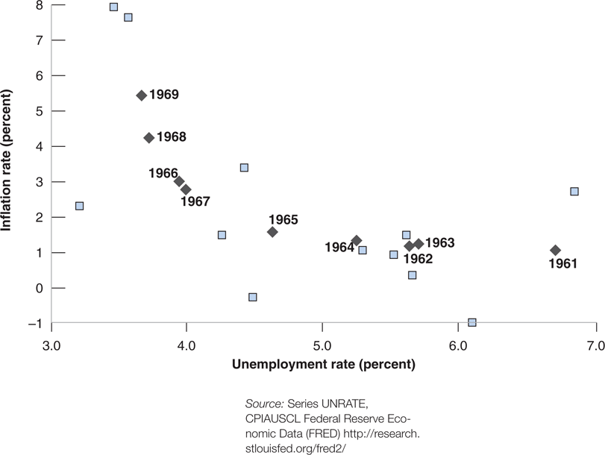
1948-1969

Slide 5
1948.Q1-1973.Q3

Slide 6
1973.Q4-1975.Q1

Slide 7
1973.Q4-1975.Q1

Slide 8
1992.Q1-1999.Q4

Slide 9
1992.Q1-1994.Q4

Slide 10
2000.Q1-2014.Q1

Slide 11
2000.01-2019.01

Slide 12
2000.01-2019.01

Slide 13
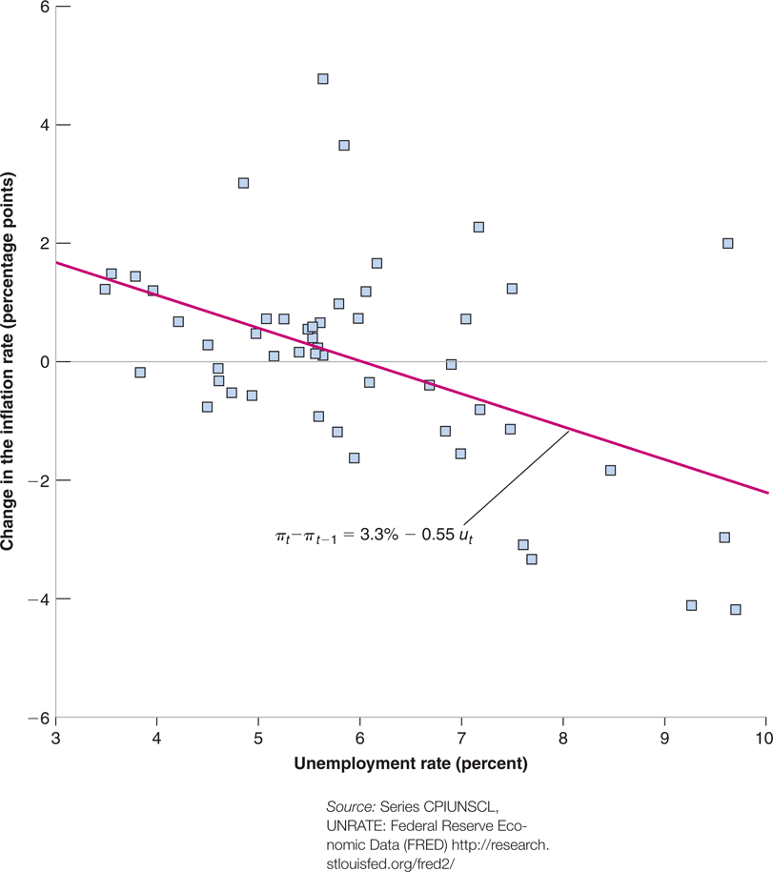
1970-2010

Slide 14
2000.01-2019.01

